Slide 1



January 21, 2026
Building Resilience
Through Connection
Kate Chutuape, MPH
VHC Health
Manager, Senior Health Dept.

Slide 2

The Caregiver Reality
  Caregiving is meaningful but emotionally and physically demanding
  Stress, burnout and isolation are common
  Many caregivers try to “do it all” alone

Slide 3

What is Resilience?
  Resilience is the ability to adapt and recover from life’s challenges
  Grow stronger through support, skills and connection

Slide 4

Connection Matters
  Humans are inherently social beings
  Sharing experiences reduces feelings of isolation
  Being understood builds emotional strength and hope

Slide 5
Support Groups and Connection

Slide 6

Support Groups
  Support groups provide safe spaces for caregivers to share experiences, challenges and successes
  Learn practical coping strategies from others
  Feel accepted expressing emotions and feelings of guilt, anger, exhaustion
  Share mutual understanding and encouragement

Slide 7
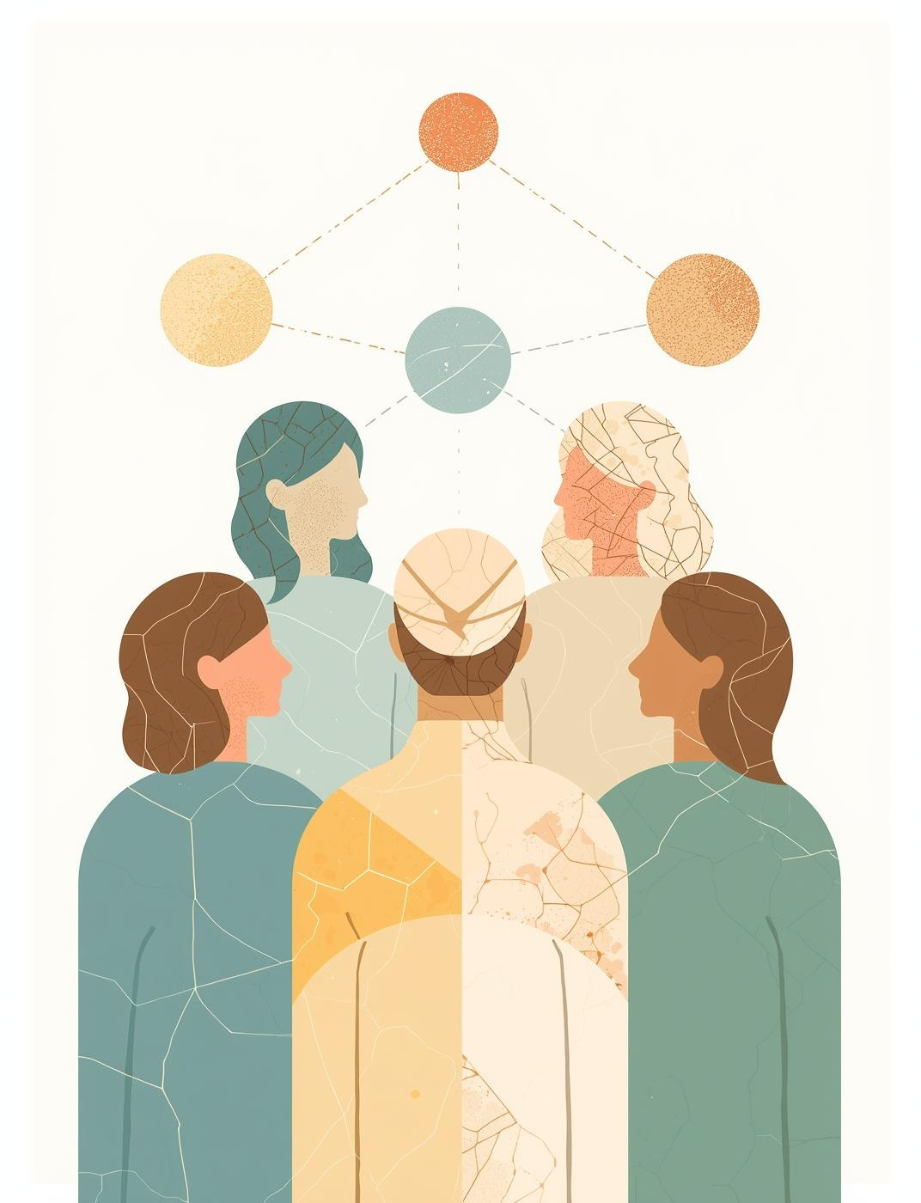
Benefits of Support Groups
  Improved mental and emotional well-being
  Reduced stress and burnout
  Increased confidence in caregiving role
  Stronger sense of belonging and purpose

Slide 8

Ways to Connect
  Virtual or in person
  Online communities
  Peer mentoring, family check-ins
  Local organizations

Slide 9

Local Resources
  City of Alexandria's Older Adult Clinical Services and the Adult Day Services Center offers a caregiver support group
  Support groups may also be specific to an issue/condition, such as dementia, stroke, diabetes, etc.
https://www.vhchealth.org/classes-events/support-groups/

Slide 10

Key Takeaways
  Caregivers can rely on each other for support
  Connection is not a luxury -it’s essential!
  Building connections builds resilience and promotes overall well-being

Slide 11

VHC Health Services
VHC Health offers comprehensive medical services
including primary & specialty care
Old Town
700 S. Washington St.
Primary care
Cardiology
Cardiovascular Diagnostics
Physical therapy
West Alexandria
3475 N. Beauregard St.
Primary care
Urology
Podiatry
Wound care & hyperbaric medicine
Physical therapy
Kingstowne
5971 Kingstown Village Pky.
Primary care
Cardiology
Gastroenterology
Urology

Slide 12
Questions
VHC Health
Senior Health Department
Email
seniorhealth@vhchealth.org
Phone
703.558.6859

