Slide 1
Resilience and Renewal: Caregiver Workshop
City Resources
for Caregivers

Slide 2

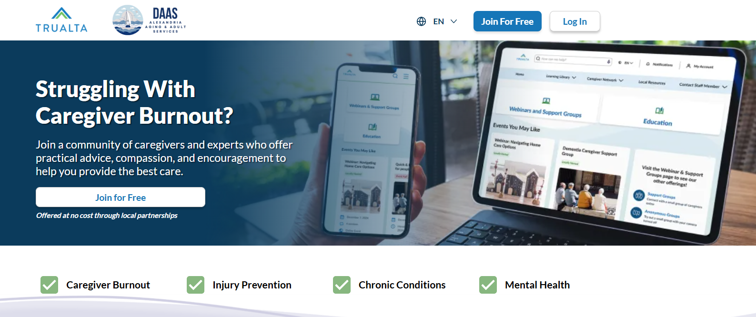
AlexVA.Trualta.com
  Interactive eLearning environment; delivering engaging and personalized training.
  Short, digestable lessons created by experts; professional-level training adapted for informal caregivers.
  Easy to use for all ages, completely private, and accessible 24/7
  No app required, view on any browser, computer, laptop, phone or tablet
Print material is available to supplement the digital platform
Notes:
AlexVA.trualta.com is an online platform designed to support caregivers with exactly what they need, right when they need it.
- It's packed with information, lessons, and resources tailored to each caregiver’s specific care situation—because no two caregiving journeys are the same.
- Caregivers can connect with others who truly get what they’re going through via:
- Online support groups for shared experiences and advice
- Educational webinars that dive deeper into caregiving topics
- Our content is short and sweet—most are just 2 to 8 minutes long—because we know caregivers are busy enough as it is.
- Everything on the platform is professional-level training that’s been carefully adapted for informal caregivers, making it both practical and easy to understand.
- Best of all, AlexVA.trualta.com is available 24/7, whether you’re on a computer, tablet, or smartphone.
- So, whether it’s a quick tip at 2 PM or a late-night search for answers, this resource is available when caregivers need it most.

Slide 3
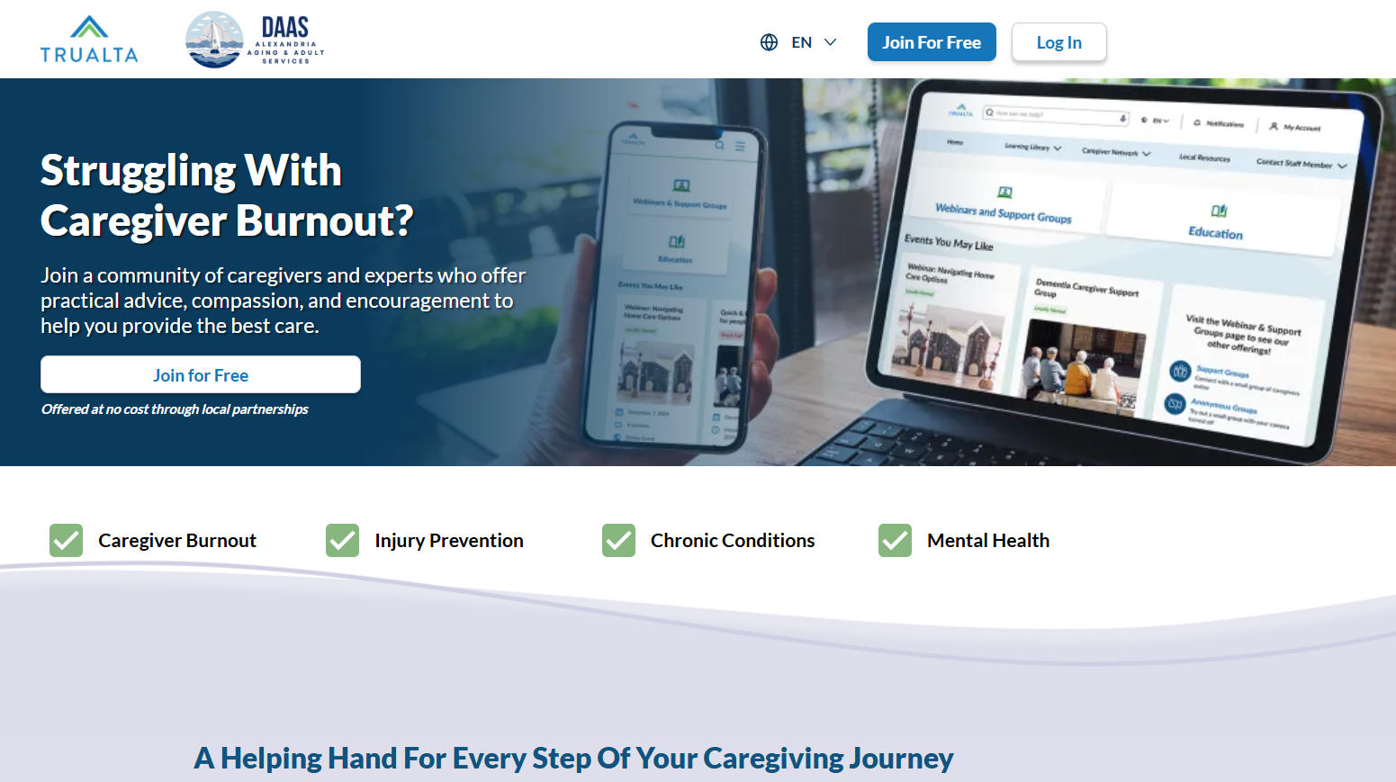

Notes:
Here what our front page looks like and how you can join.

Slide 4

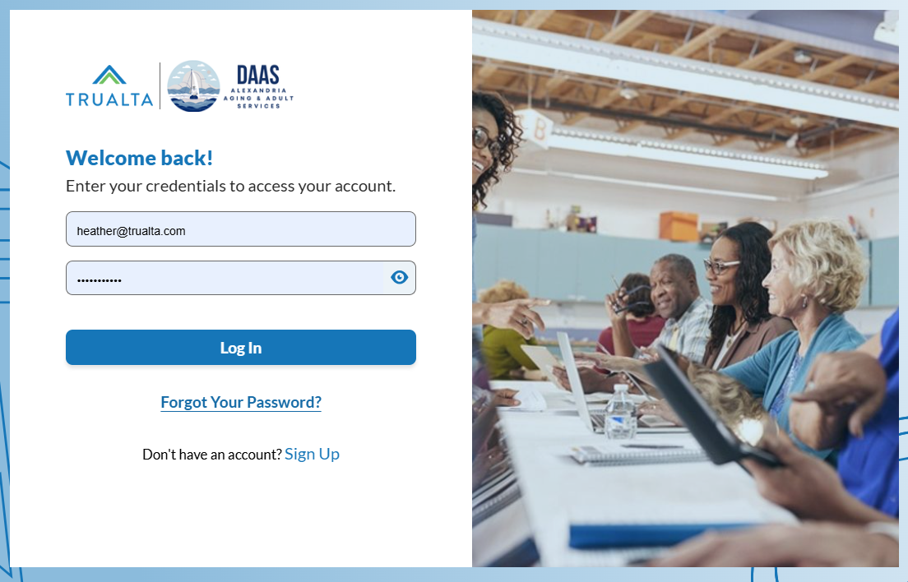
AlexVA.trualta.com
Notes:
The Single Sign-On (SSO) will appear and you will be able to access your account by entering your login.
Once you have completed the login fields, you will be directed to the home page.

Slide 5
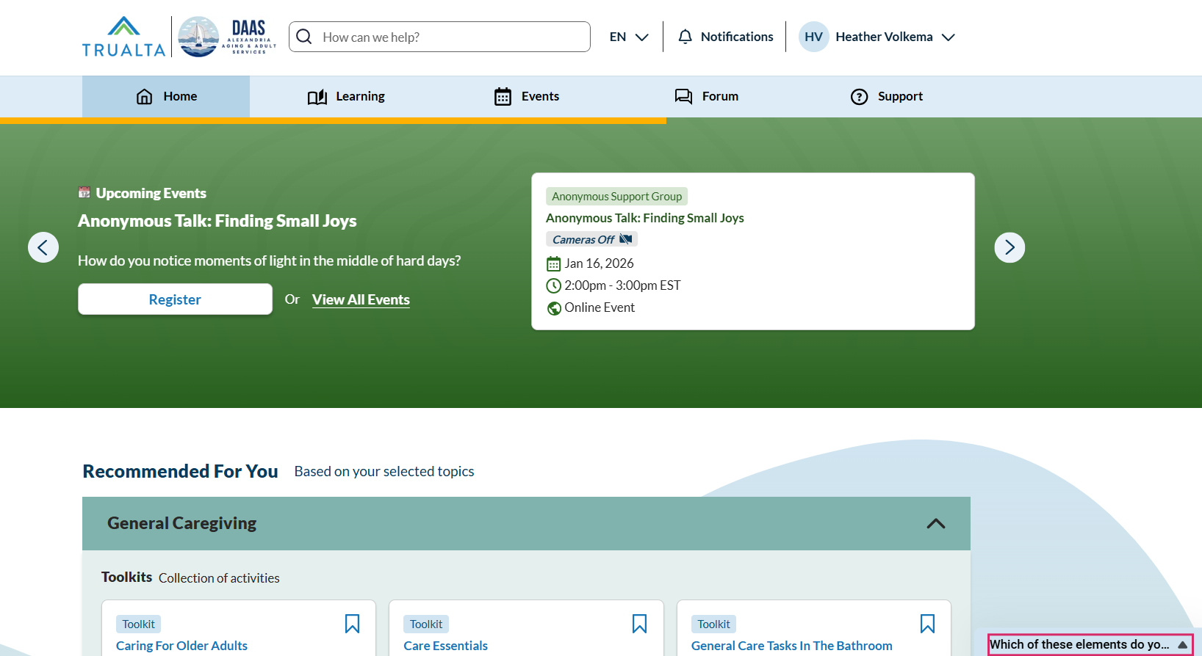
Notes:
Let's take a look at the caregiver view of the homepage!
Where you will see all of your options across the top on the light blue bar
If you look near the yellow arrow, you will see that the word “HOME” is highlighted,
Indicating you are on the homepage
On this page you will see a rotating banner letting you know of upcoming events or pieces of content that you might want to check out

Slide 6
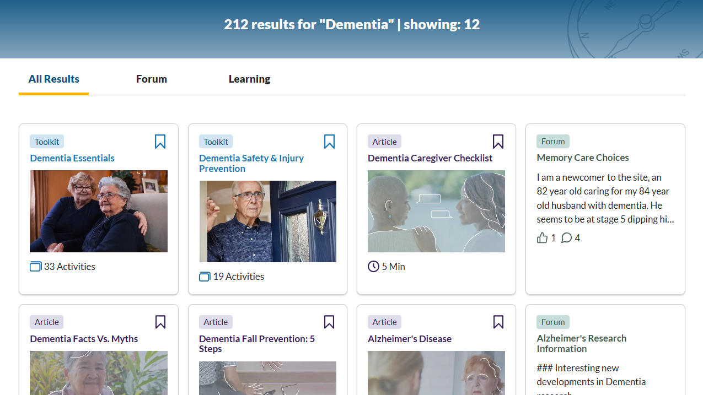
Notes:
This is how we organize our content
Each tile will tell you
the title
about how long it will take you to read or watch the content
The format - whether it is an article, video, scenario, or resource
And then give you the opportunity to save it by clicking that little ribbon in the right hand corner of the tile
Remember that organization tab called “My Learning”??
If you “save” the tile, it will save in your My Learning tab so you can find it again quickly
Let’s take a look at what it looks like when you click on a tile

Slide 7
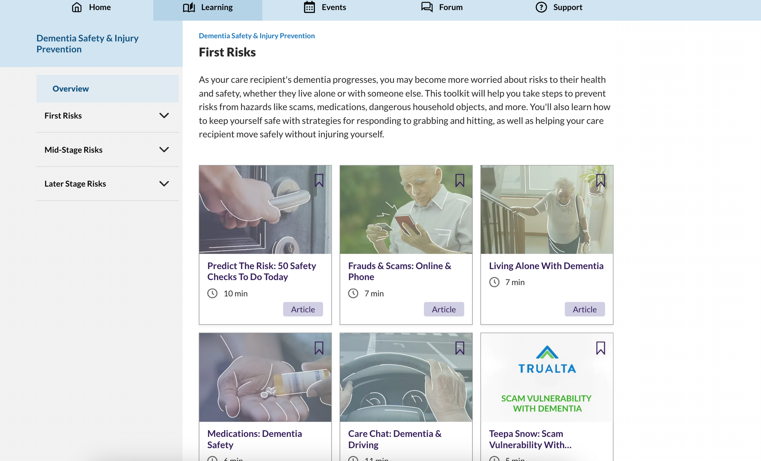
Notes:
The format of all the content in this toolkit is displayed. An estimation of how long it will take to complete the content and a bookmark icon is displayed in the right hand corner of each content title, for future reference. The left hand menu displays a concise table of contents menu which can also be used to navigate the tool kit content,

Slide 8
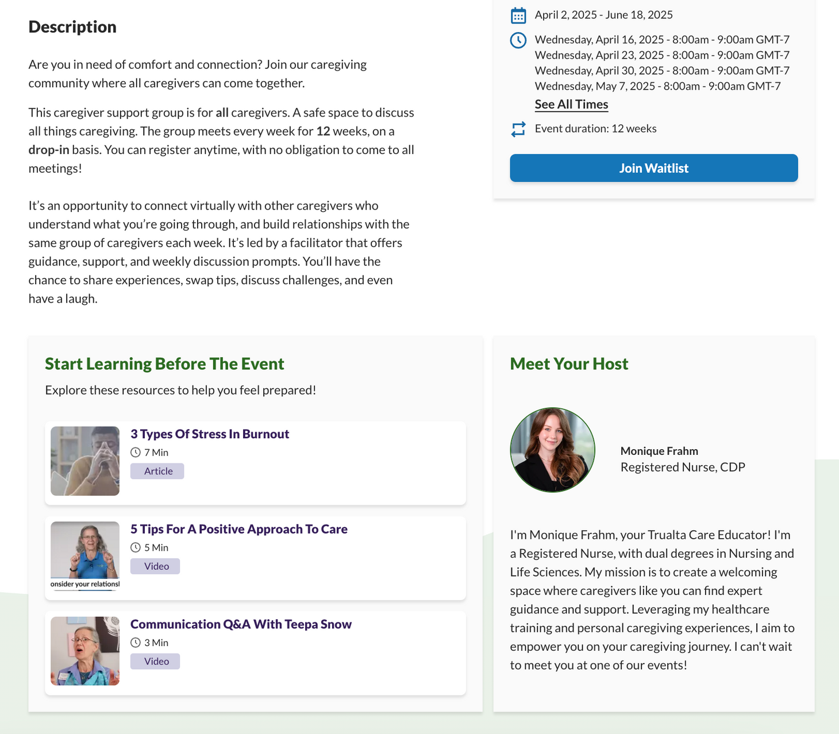
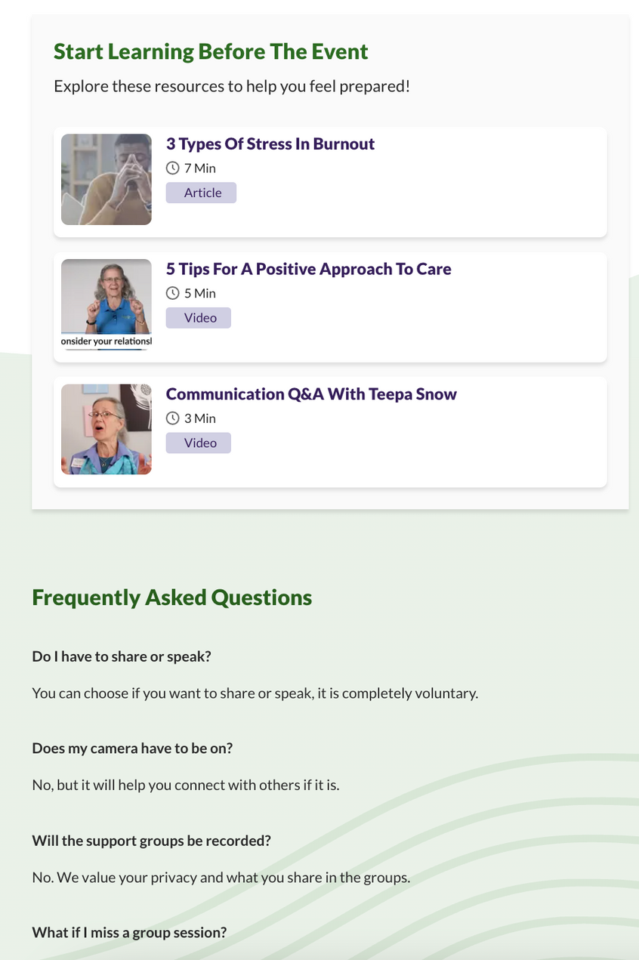
Notes:
If you click on an event (like this webinar called Dementia Deep Dive)
It will provide you all the information about that specific event
You can see the title at the top followed by a description
Near the small yellow arrow, you will learn who is hosting the event
And near the larger arrow, you can see the date/time and the button to register
Once you register, you will receive a confirmation email and also reminder emails so you don’t forget!

Slide 9
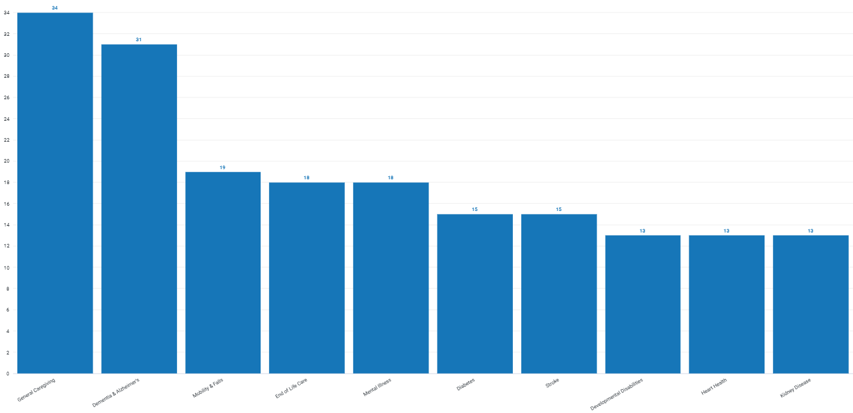
Key Metrics - Adoption
Why are your caregivers coming to Trualta?
Notes:
General caregiving, dementia,

Slide 10
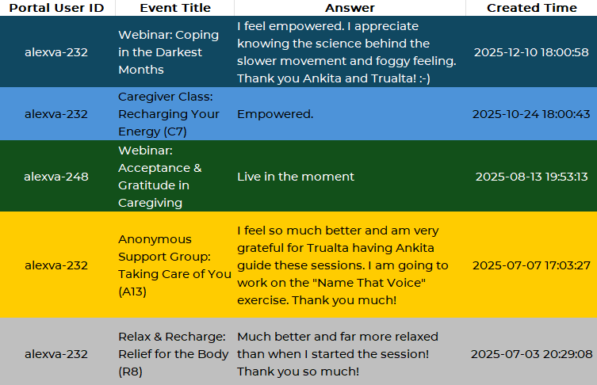
Voice of the AlexVA Caregiver

Slide 11
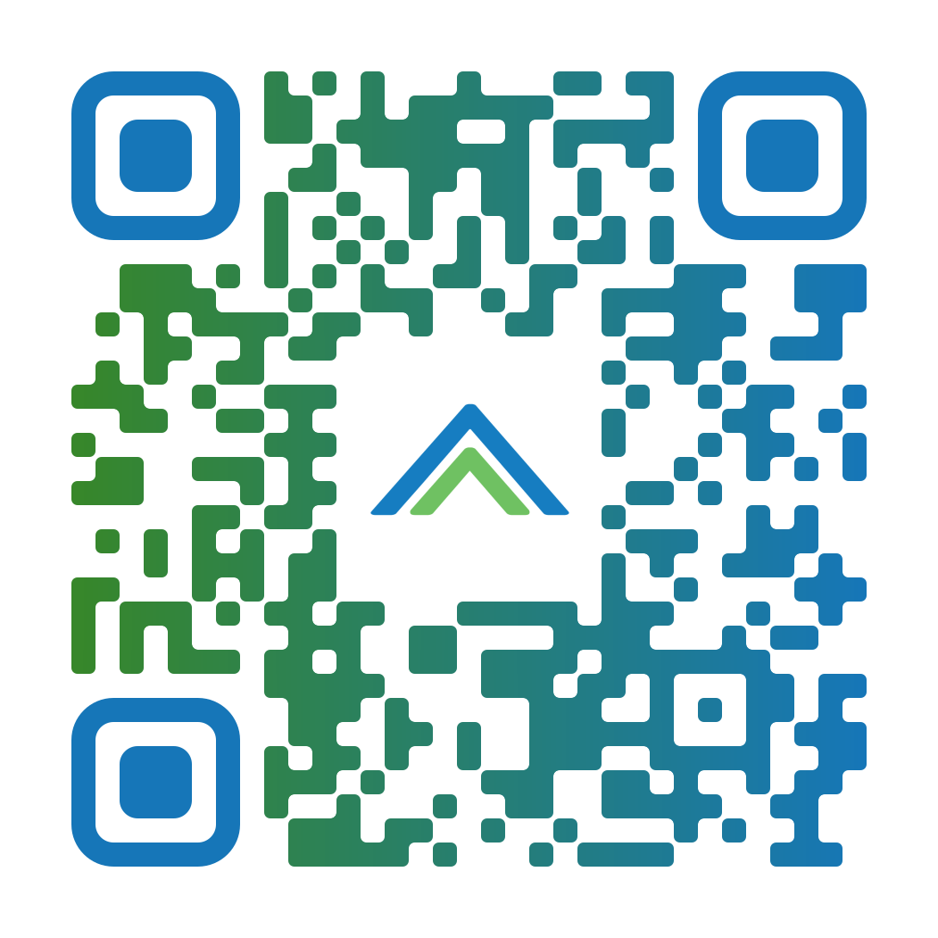
AlexVA.Trualta.com
Notes:
Also get to the site by going to city of Alexandria, type in aging

Slide 12
The Caregiver Space
Free bi-monthly support group for older adult caregivers run by a senior therapist with the Older Adult Mental Health Team at the City of Alexandria Community Services Board.
Scheduled dates are January, March, and May with a facilitator.
Caregivers meet in February, April, and June without a facilitator.
Share challenges and experiences.
Meetings held the second Thursday of each month from 3-4 p.m.
There is no cost to attend.
romita.afzal@alexandriava.gov | 703.328.8505

Slide 13
Adult Day Services Center
5-day per week program, 8 a.m. – 5 p.m.
City residents age 55+
Therapeutic recreation
Nursing service, including medication monitoring and administration
Nutritious noon-time meal and snacks
Transportation using the DOT program
Supportive services for caregivers

Slide 14
Personal Emergency Response System (PERS)
Help button that assists in a medical emergency.
Lightweight, waterproof and can be worn around the wrist or necklace.
For assistance, press the help button to speak directly through a base unit with an operator in the Response Center. The base unit allows for hands-free, two-way communication.
The operator contacts the appropriate medical personnel and shares the information provided in the subscriber profile.
Residents may qualify with an income of less than $1,956.00/month.
Apply privately by calling 516.394.2752 or emailing clientsupport@connectamerica.com

Slide 15
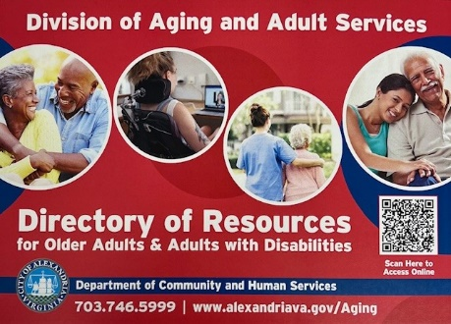
Contact Information
Division of Aging and Adult Services
  4850 Mark Center Drive, 9th Floor
  Alexandria, VA 22311
  703.746.5999
  DAAS@alexandriava.gov
  Information and referral line is open weekdays,
  8:30 a.m.- 4:30 p.m.
  Alexandriava.gov/aging

