Slide 1

A Walk Through a Safer Home
A step-by-step guide to reducing Fall Risk in your space and unlocking your
next chapter with Crouch Realty Group.

Slide 2

Exterior and Entry
DIY / Handyman Fixes:
  Replace bulbs with dusk-to-dawn fixtures
  Heavy, non-slip doormat
  Landing bench or table
  Clean walkways

Slide 3

Exterior and Entry
Contractor-Level Improvements:
  Add second handrail
  Install pathway/motion lights
  Rebuild uneven steps
  Illuminated high-contrast house numbers

Slide 4
Hallways and Stairs
DIY / Handyman Fixes:
  Secure or remove area rugs
  Motion nightlights
  Tote for carrying items
  Contrast tape on stair edges
Contractor-Level Improvements:
  Add second handrail with returns
  Improve stair lighting
  Replace flooring with low-pile carpet

Slide 5
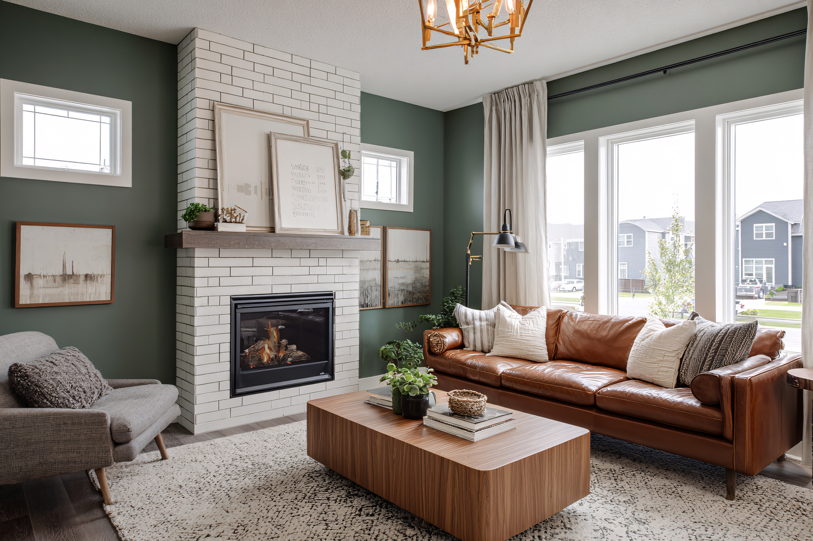
Living Room
DIY / Handyman Fixes:
  Lamps or sconces on switches
  Cords secured along walls
  Clear pathways
  Rugs with non-slip pads

Slide 6
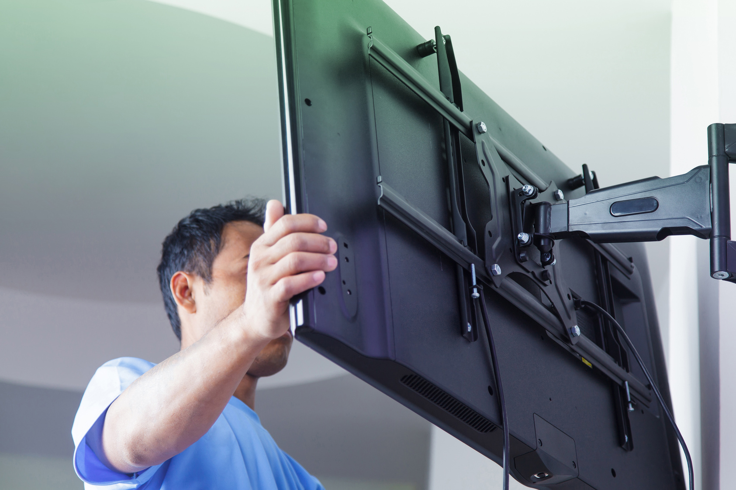
Living Room
Contractor-Level Improvements:
  Hardwired lighting
  Add outlets
  Professional TV mounting

Slide 7
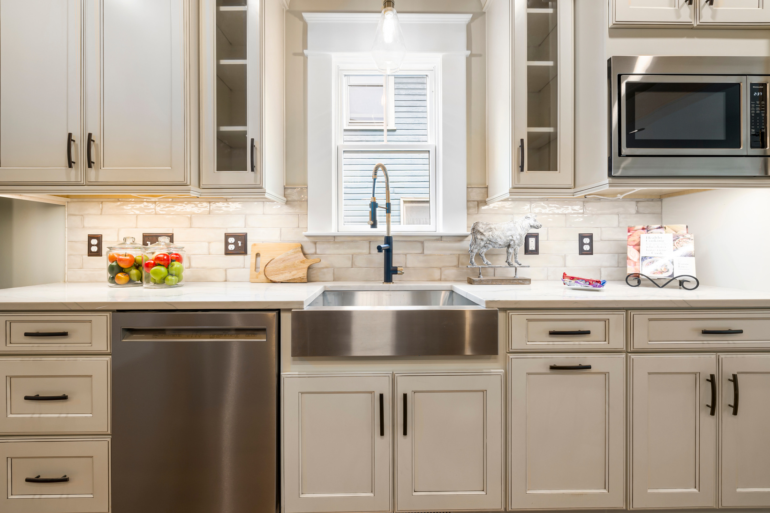
Kitchen
DIY / Handyman Fixes:
  Bright LED task lighting
  Countertop microwave
  Non-slip mats

Slide 8
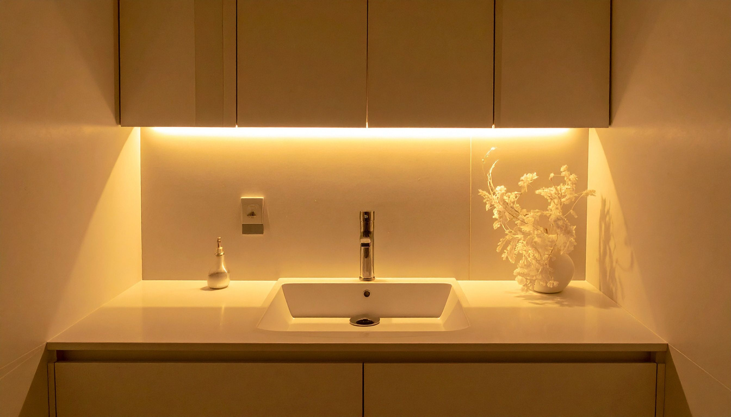
Kitchen
Contractor-Level Improvements
  Under-cabinet lighting
  Non-slip flooring
  Adjust counter height

Slide 9
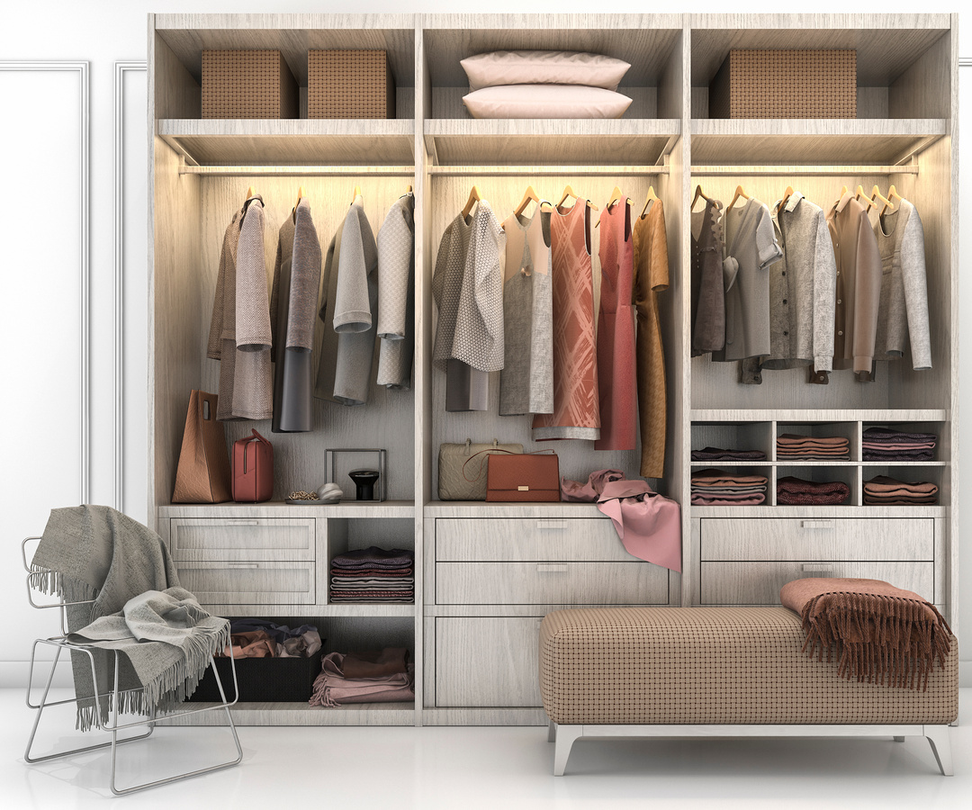
Bedroom
DIY / Handyman Fixes:
  Motion or remote lights
  Clear pathways
  Chair near closet

Slide 10

Bedroom
Contractor-Level Improvements:
  Add wall switch at entry
  Install overhead lighting
  Widen doorways

Slide 11
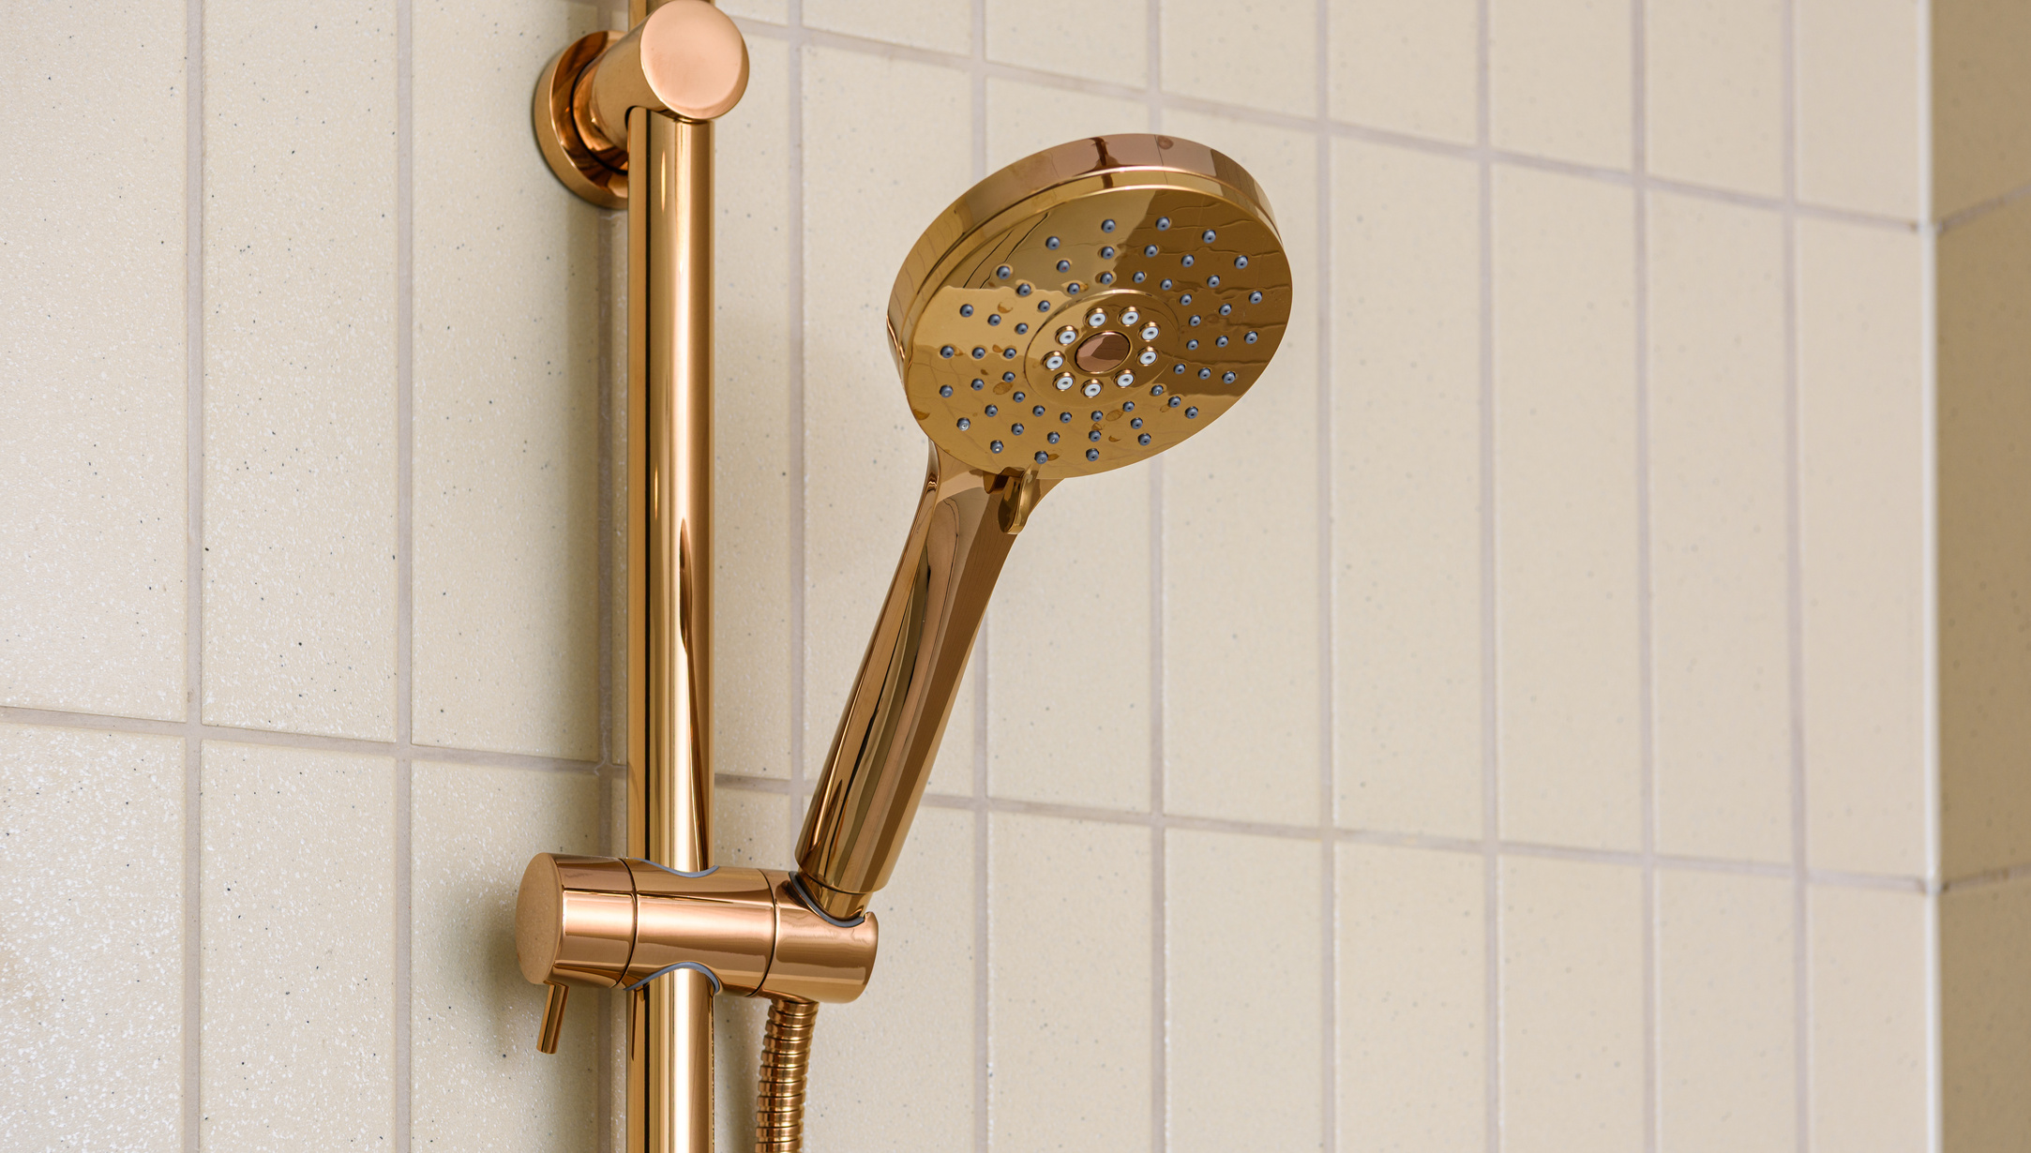
Bathroom
DIY / Handyman Fixes:
  Rubber-backed mats
  Handheld showerhead
  Surface-mount grab bars
  Raised toilet seat

Slide 12
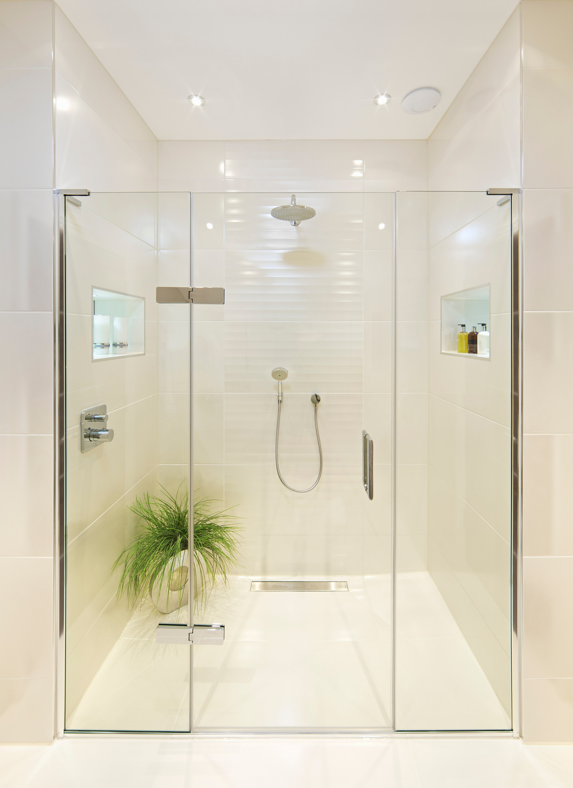
Bathroom
Contractor-Level Improvements:
  Hi-boy toilet
  Low-/no-threshold shower
  Permanent grab bars
  Non-slip flooring

Slide 13

General and Seasonal
DIY / Handyman Fixes:
  Sweep leaves
  Apply ice melt
  Gutter cleaning- by a Pro!
  Traction mats

Slide 14
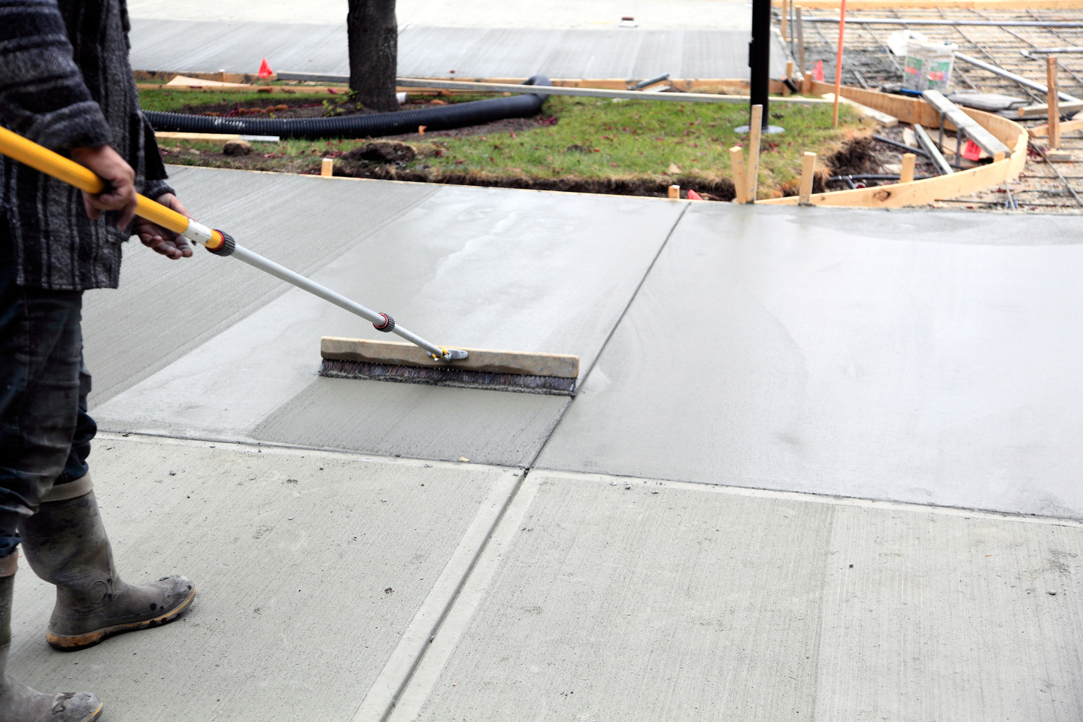
General and Seasonal
Contractor-Level Improvements:
  Install gutter guards
  Repair uneven walkways
  Add exterior lighting

Slide 15
When It’s Time to Right-Size
DIY / Handyman Fixes:
  Start Decluttering early
  Begin identifying potential problem areas in your home (things that need fixing, etc.)
Contractor-Level Improvements:
  Book your complimentary Strategy Session with Crouch Realty Group
  Follow our Downsizing Program

Slide 16



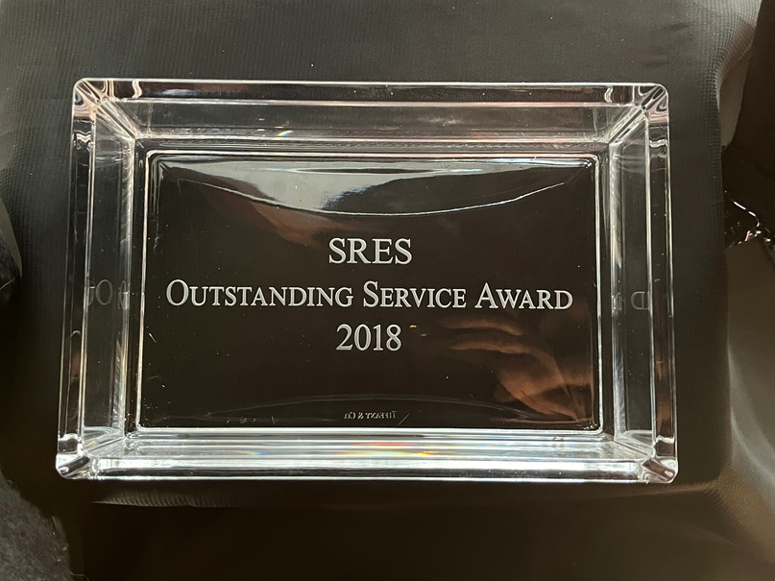

We’re Here to Start the Conversation
Your next chapter is waiting — and we’d be honored to help you step into it.
CONTACT:
Licensed in VA | CrouchRealtyGroup.com
Peter 703.244.4024 | Pete@CrouchRealtyGroup.com
Katie 703.447.1345 | Katie@CrouchRealtyGroup.com
CorcoranMcE.com | Corcoran® and the Corcoran Logo are registered service marks owned by Corcoran Group LLC. Each office is independently owned and operated. Not intended to solicit the listings of other brokers.

