Slide 1

Stress Management
Senior Health Department
(703) 558-6859
Notes:
Everyone experiences stress now and then. But the effects of stress on older adults can be greater than in other age groups. The unique relationship between stress and aging can cause new health problems and worsen existing ones. Stress even speeds up the aging process itself.
Successful agers tend to have a few things in common. They stay connected to friends and family, they exercise and keep active, and above all they find ways to both reduce and manage stress in their lives.

Slide 2
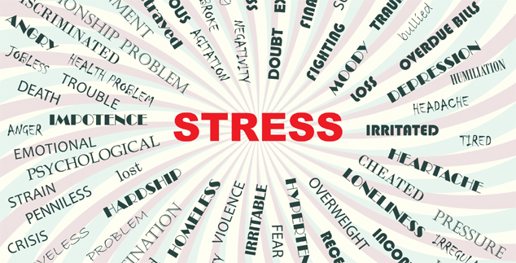
Definition of Stress
A response, physiological and emotional, that is activated when we perceive a situation as a challenge or difficult
Notes:
a physical, chemical, or emotional factor that causes bodily or mental tension and may be a factor in disease causation
d: a state resulting from a stress especially : one of bodily or mental tension resulting from factors that tend to alter an existent equilibrium

Slide 3

Fight or Flight:
The Body’s Stress Response
The brain gets a danger message from one of the senses
Body gears up for a physical response (fight or flight)
Stress hormones – mostly adrenaline and cortisol –
are released
Heart rate & blood pressure go up
Muscles tense
Breathing rate increases
“Fuel” is released for energy
“Unnecessary” body functions slow or shut down
Notes:
If you have ever found yourself in a stressful situation where you’ve noticed your heart pounding, muscles tensing up, quick breathing or started feeling sweaty, you probably have the “fight-or-flight” survival mechanism to thank – a stress response that occurs when your body perceives itself to be in danger. Fight-or-flight evolved to help humans react quickly in life-threatening or dangerous situations. Today, however, most of the things that cause us stress don’t require that type of reaction so if you body repeatedly responds to stressors that aren’t life-threatening as if they are, it can pose health problems.

Slide 4
What Do You Associate With Stress?

Slide 5
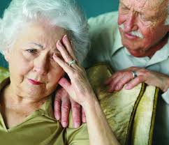
Common Stressors
Changes in lifestyle & financial status after retirement
Caregiver stress
Loss of independence
Loneliness or isolation
Death of relatives & close friends
Health problems
Moving/downsizing

Slide 6
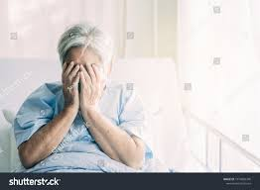
Modern Day Stress
No wild animals to fend off
No predators to run from (most of the time)
Stressors are mostly psychosocial
Many stressors are chronic
(don’t end after a few minutes)
Notes:
Psychosocial stress is the result of a cognitive appraisal of what is at stake and what can be done about it. Psychosocial stress results when we look at a perceived threat in our lives. Psychological stress can be defined as an imbalance between demands placed on us and our ability to manage them.
Result is emotional and physiological reactions experienced when an individual confronts a situation in which the demands go beyond their coping resources. Examples of stressful situations are marital problems, death of a loved one, abuse, health problems, and financial crises.
Acute stress is short-term stress that tends to go away once the situation is over. (stuck in traffic, agreement with a loved one)
Chronic stress is constant long-term stress

Slide 7
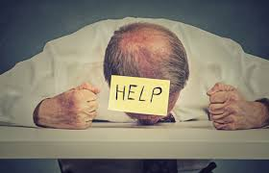
Signs & Symptoms of Stress
Physiological:
  Insomnia
  Loss of appetite or indigestion
  Muscle pain and tiredness
  Headaches
Emotional & Psychological
  Anxiety, fear, frustration, depression
  Restlessness, poor concentration, forgetfulness

Slide 8
Effects of Stress on the Body
Increased production of cortisol and adrenaline
Heart disease
High blood pressure
Weakened immune function
Short-term memory problems
linked to
Notes:
Stress hormones provide energy and focus in the short term, but too much stress over too many years can throw a person’s system off-balance
For people already at heightened risk for these illnesses, managing stress is particularly important
Extra cortisol over the years can destroy cells in the hippocampus, a brain site responsible for memory storage and retrieval.

Slide 9
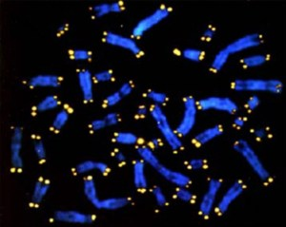
Stress & Aging
Chronic stress can accelerate aging.
People with chronic stress have shorter telomeres.
Chronic stress increases secretion of cortisol which suppresses telomerase activation
Notes:
Telomeres are areas of genetic material on the ends of a cell’s chromosomes that provide protection. As a cell divides, telomeres shorten and some of these genetic instructions are lost. An enzyme called telomerase normally prevents this, but as we grow older, our ability to make telomerase decreases, and the protective telomeres become shorter. Thus, telomere length is a basic indicator of cellular aging and telomerase activity is a measure of cellular capacity for ongoing replication.
Cells with long telomeres live longer. Short telomeres have been linked to a wide range of human diseases, including coronary heart disease, osteoporosis and HIV infection. Shortening of telomeres is prevented or reduced by telomerase, which has been shown to keep immune cells young by preserving their length and ability to continue to divide and reproduce accurate replicas.
cortisol also suppresses telomerase activation in immune system cells so that telomeres are no longer protected during cell division and become progressively shorter. This leads to early cell aging and distorted replicas of the original cell that could lead to cancer and other diseases. As the lead author noted in an interview, “We are testing therapeutic ways of enhancing telomerase levels to help the immune system ward off cortisol’s effect. If we’re successful, one day a pill may exist to strengthen the immune system’s ability to weather chronic emotional stress.”
Reference:

Slide 10
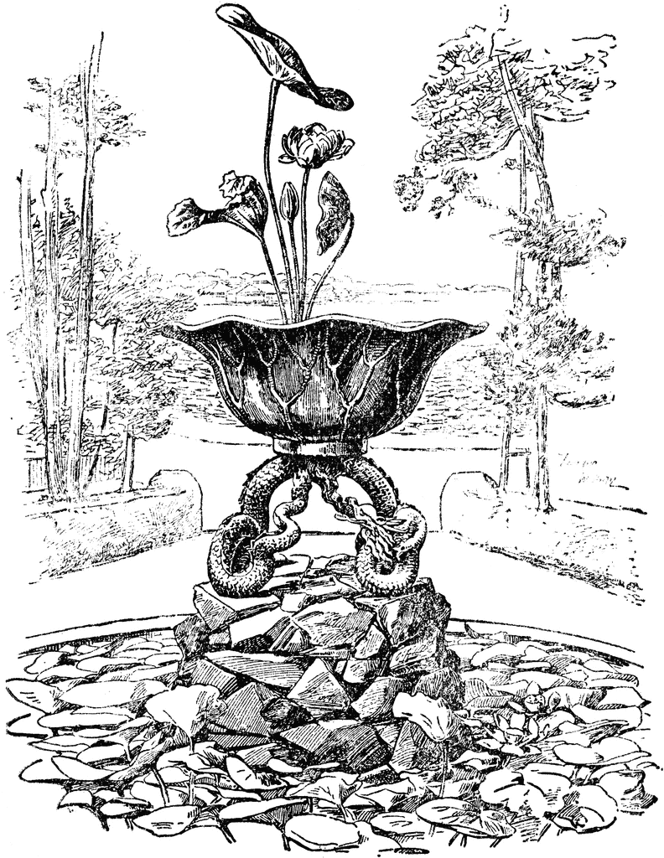
Stress Management – The Real Fountain of Youth?
Notes:
The good news is that we can put what we know about stress and aging to work for us. Learn to manage and reduce your stress and you have a better chance to live a long, healthy life.

Slide 11
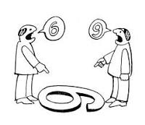
Perception
“If you change the way you look at things,
the things you look at change.”

Slide 12
What Do We Mean By That?
Nothing is stressful in and of itself.
Something becomes stressful because you perceive that it is.
Your perception is affected by your personality, background, education and experience; as well as the type of situation.
Your level of overall wellness helps determine
your coping resources.

Slide 13
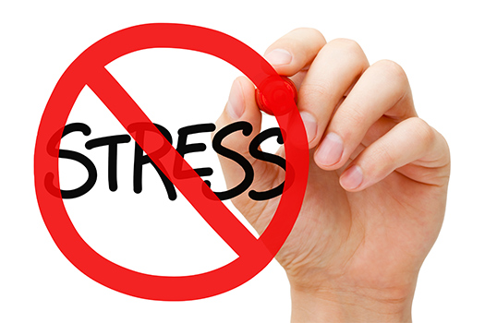
Over Your Optimum Stress Point? Consider Making a Change…
Is there a stressor that can be eliminated?
Can you change how you think about a stressor?
Can you change how you interact with a stressor?
Can you learn to live more peacefully
with it?

Slide 14
Seven Steps to Stress Mastery
Develop an awareness of stressors
and stress symptoms
  Emotional, physical, behavioral
Figure out exactly what is bugging you?
  Keep a journal, take a mental inventory
Check for underlying causes
  Caregiving stress, poor health, loneliness

Slide 15
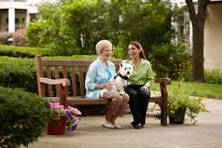
Seven Steps to Stress Mastery
Control
  Avoid, eliminate or change
Reframe and rethink
  You control your reaction
Relax and rejuvenate
  Sleep, exercise, play and relax
Make Stress Management a habit
  Allow time for stress busters every day
Notes:
4. Removing source of stress isn’t always possible, but if you can, try to identify what’s causing your stress and so something to change that. Seek support – while stress is a natural part of life, carrying the burden all by yourself takes a toll – this is especially important for caregivers.
6. Eating a healthy balanced diet can boost the immune system, help combat the effects of inflammation and fuel positive energy. Exercise helps lower BP, ease arthritis pain, combat chronic illness and lift your mood. Exercise releases feel-good endorphins while reducing the level of stress hormones like cortisol. Sleep is a time when the body repairs itself and the mind takes a break. Establishing “sleep friendly” routines can help both to reduce stress related insomnia and other negative effects.

Slide 16

COPING BEHAVIORS
What is in your toolbox?
Notes:
Play Tape

Slide 17

Stress Management Techniques
Coping techniques
  Journal writing
  Hobbies
  Spirituality
  Art/humor “therapy”
  Support groups
  Resource management (time and $)

Slide 18

Stress Management Techniques
Relaxation techniques
  Meditation
  Mindfulness
  Exercise
  Mental Imagery
  Progressive Muscle Relaxation
  Guided Visualization
  Massage Therapy
  Tai Chi
  Pet therapy
  Aromatherapy
  Yoga
  Deep (diaphragmatic) breathing
Notes:
Coping techniques- address the causes of stress, relaxation techniques- address the symptoms of stress

Slide 19
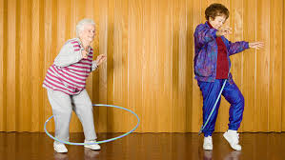

Stress Management Techniques
Maintain positive outlook
Stay close to family & friends
Notes:
People who feel good about themselves as they get older live about 7 ½ years longer than “glass half empty” types. People with more positive attitudes deal with stress better and have a stronger will to live.
Staying close to family & friends is excellent way to cut down on stress. Social support can help prevent stress and stress-related diseases. Research has shown that social support can slow down the flow of stress hormones in seniors. Social interactions can also help people stay mentally sharp .

Slide 20
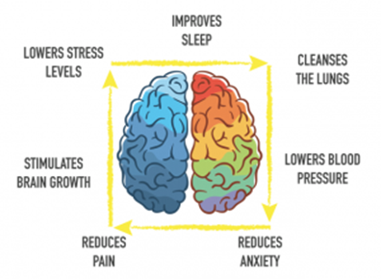
Box Breathing
Imagine that each element of your deep breathing forms
part of a square. Each element should last at least 3 seconds.
INHALE
PAUSE
EXHALE
PAUSE
Repeat…
Notes:
According to the Mayo Clinic, a medical research clinic in the United States, there is a sufficient amount of evidence to suggest that intentional deep breathing can actually calm and regulate the autonomic nervous system, a system which regulates involuntary body functions like temperature. It can lower blood pressure and provide an almost-immediate sense of calm, and improve your mood. But the benefits of deep breathing also extend beyond in-the-moment stress relief.
It’s an exceptional treatment for conditions like generalized anxiety disorder, panic disorder, post-traumatic stress disorder, and depression.
It can also help treat insomnia by allowing you to calm your nervous system at night before bed. Box breathing can even help with pain management

Slide 21
“There’s nothing either good or bad,
but thinking it makes it so...”
        -William Shakespeare-Hamlet
“There is more to life
than increasing speed.”
        -Mahatma Gandhi

Slide 22

THANK YOU!
Questions?

