Slide 1







Helping Alexandria’s Older Adults Age with Dignity

Slide 2
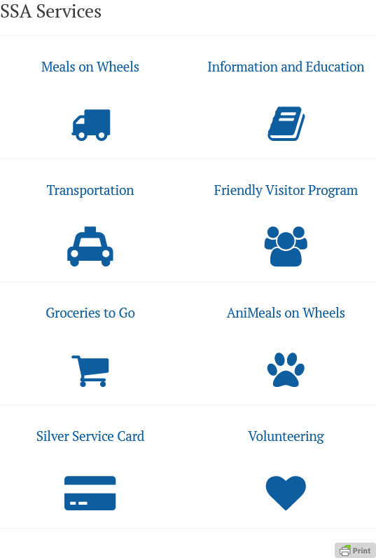
Our Programs:
Senior Services of Alexandria (SSA) is a non-profit organization that has been supporting older Alexandrians for over 55 years. We help seniors age with dignity and independence with our many programs. Our educational resources, including monthly webinars and the Senior Ambassador Program, keep seniors informed and connected. By providing these essential services, SSA enhances the physical, emotional, and social well-being of seniors, ensuring they live a fulfilling life while preventing isolation.

Slide 3
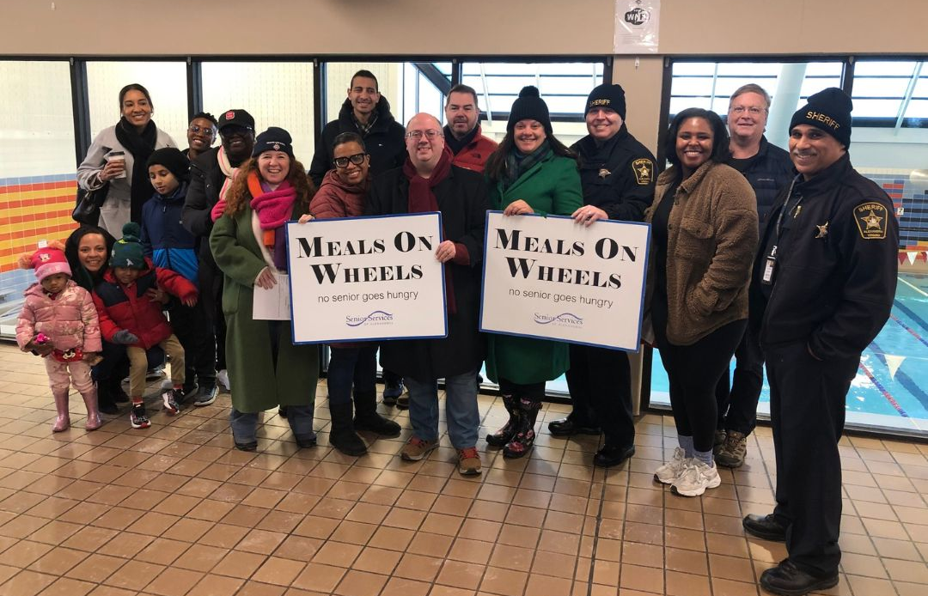
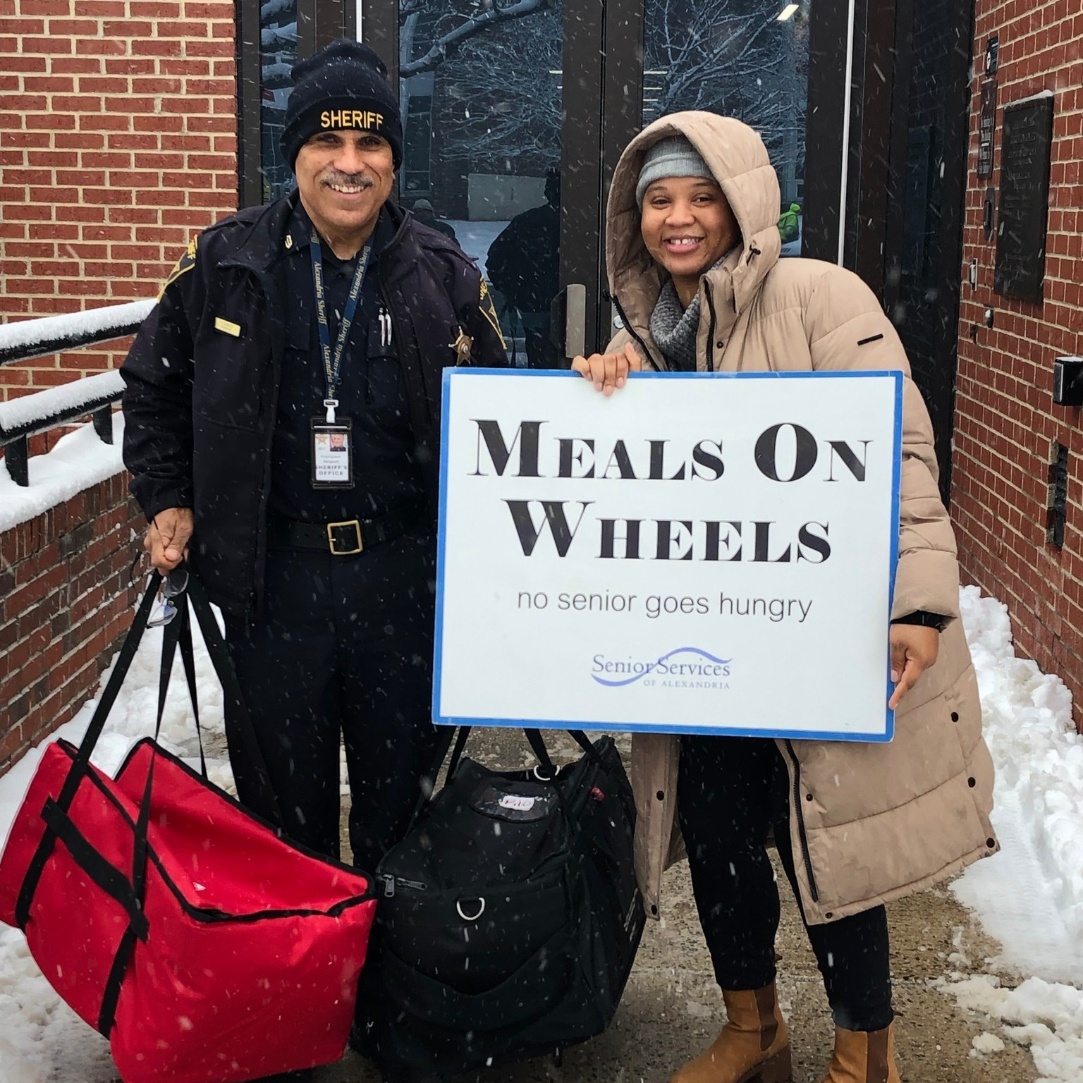

Meals on Wheels
&
Groceries to Go
Senior Nutrition Program

Slide 4
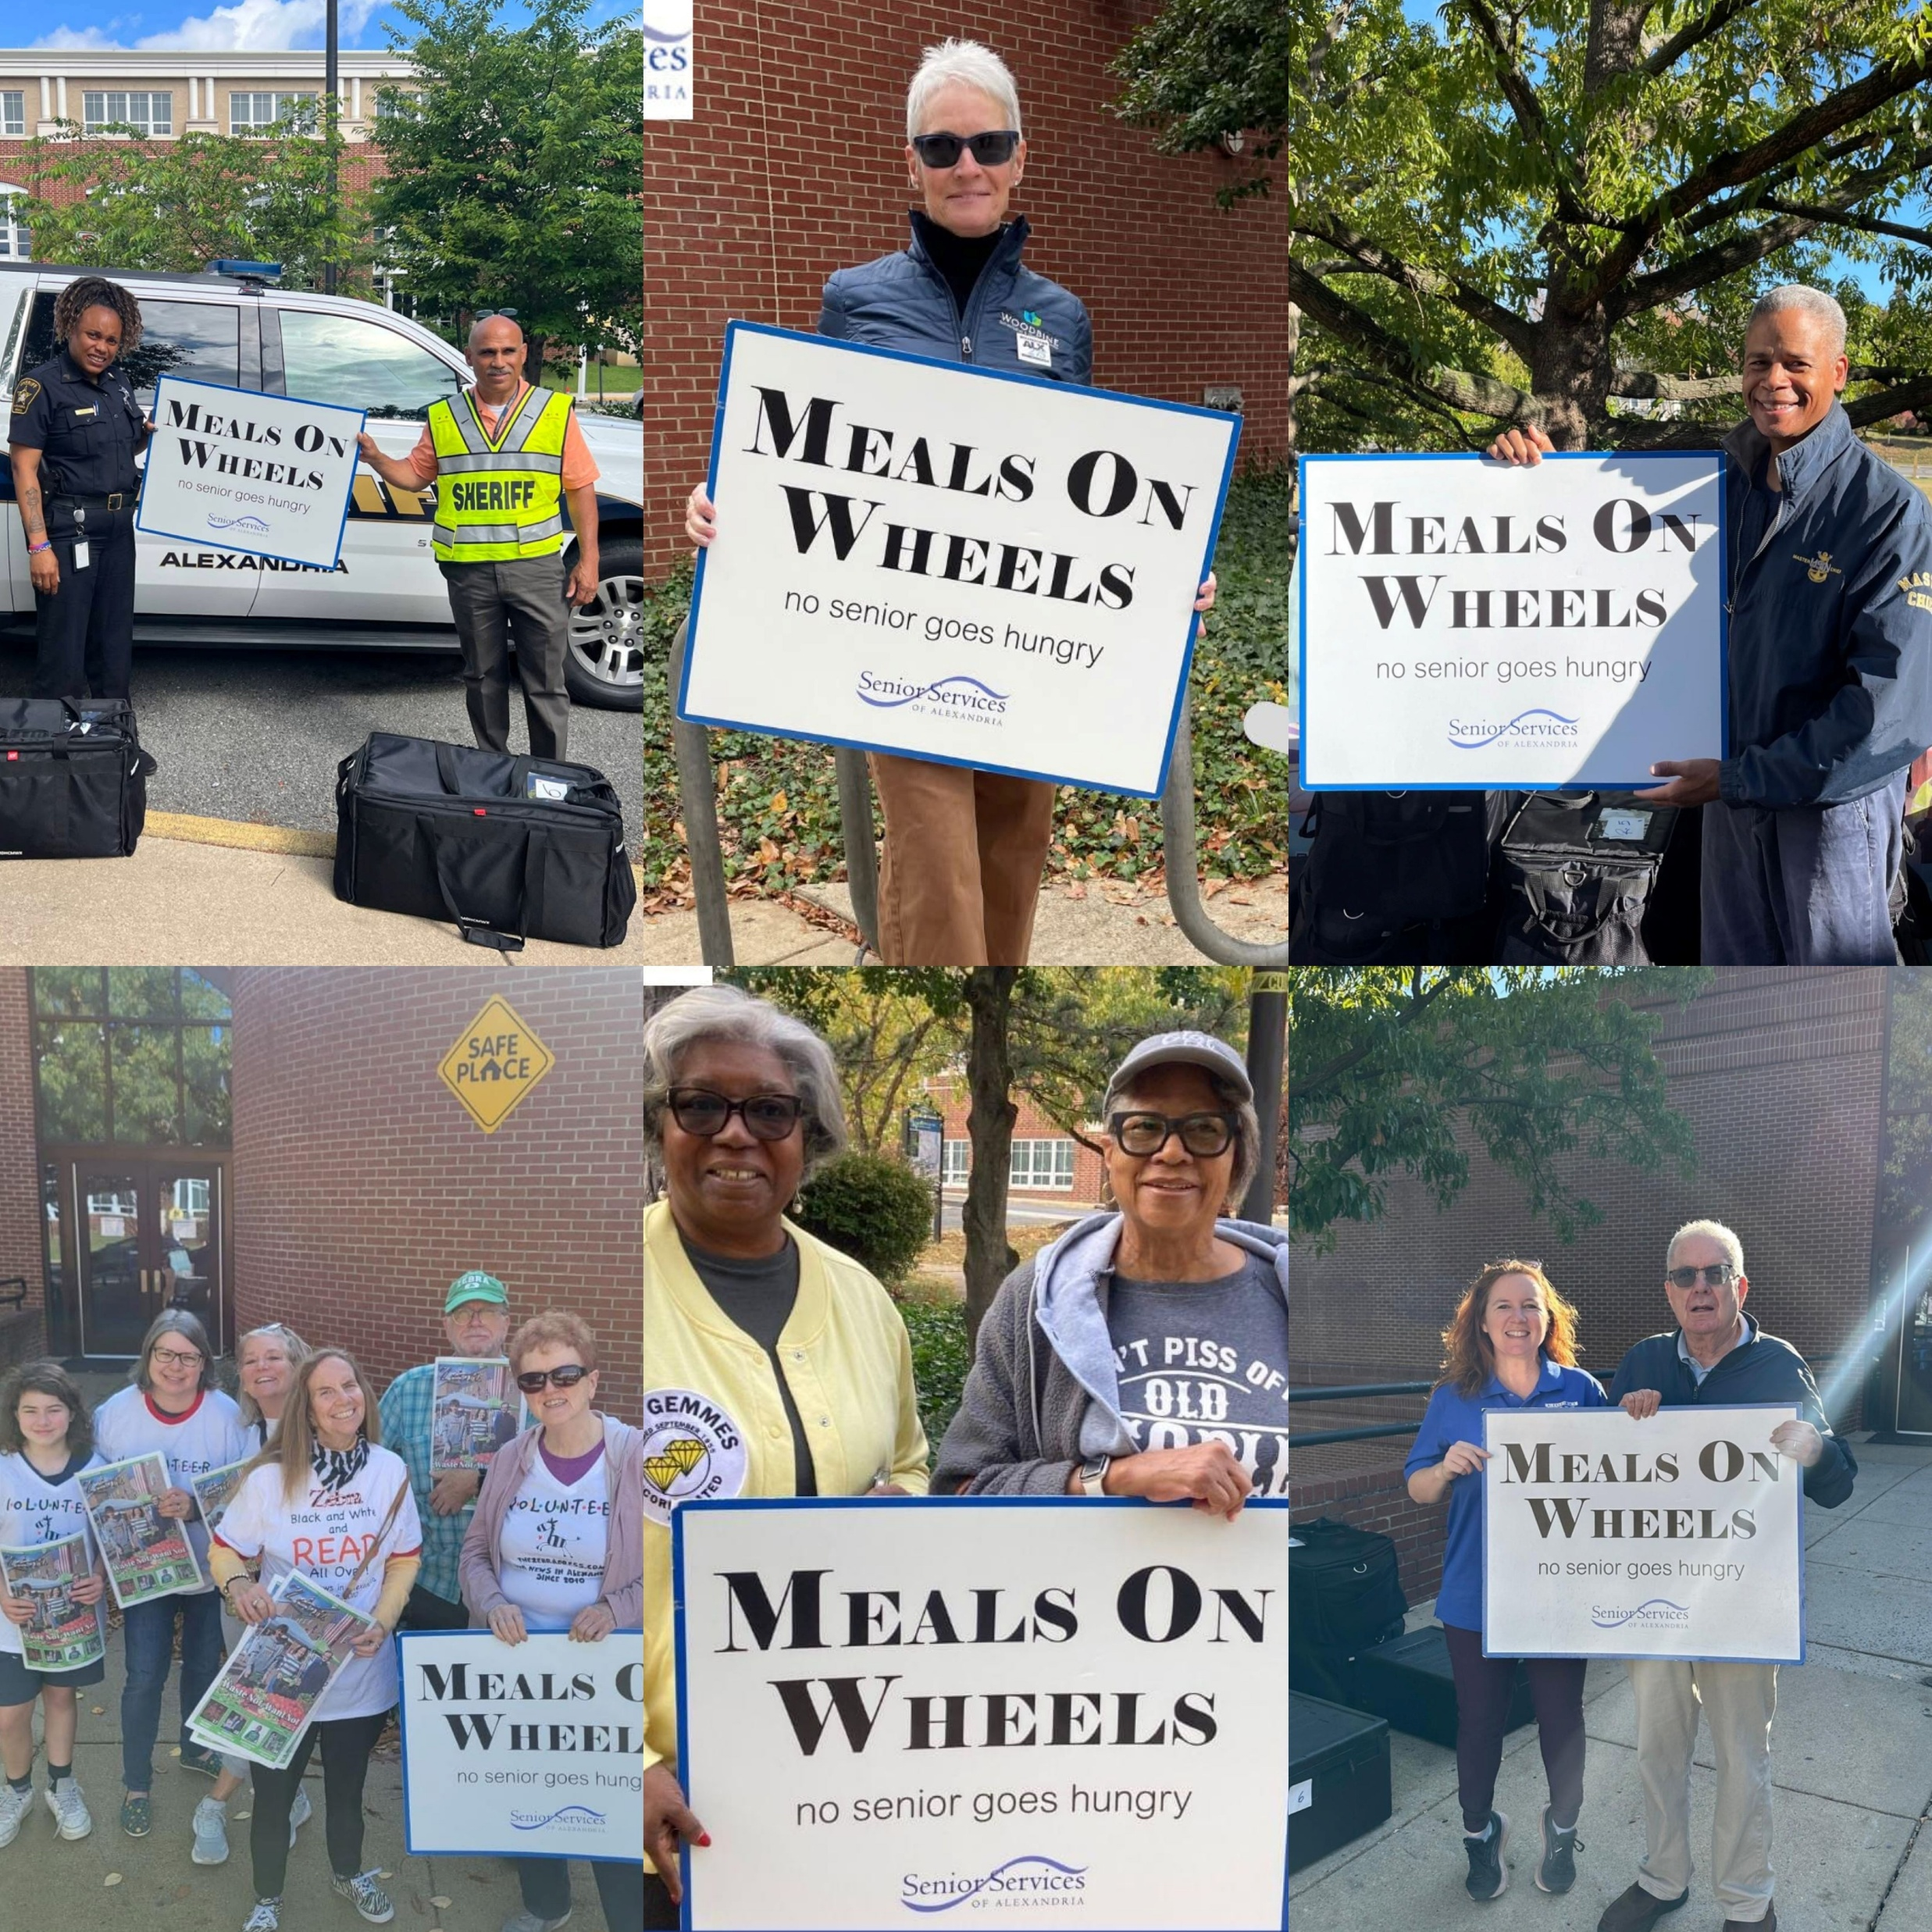
Meals on Wheels
Delivered 7 days a week to homebound seniors 60 and older
The 3 Ways We Do This:
City Subsidized
Private Pay
Sponsorship Program

Slide 5
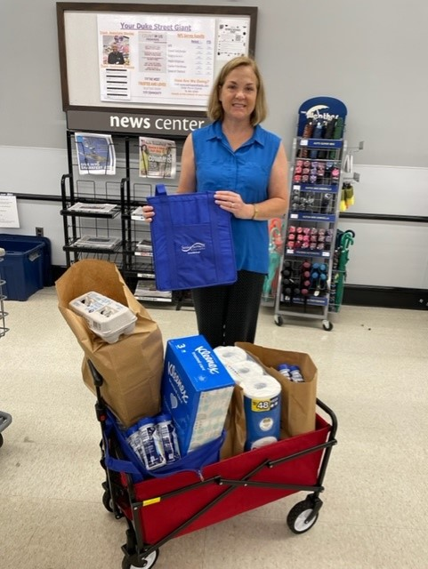
Groceries to Go
Volunteers deliver groceries purchased by phone or email to older adults who find shopping difficult.
Choice of Giant, Harris Teeter, Safeway
Volunteer Shops Every Two Weeks
No Delivery Fee, No Minimum Order

Slide 6
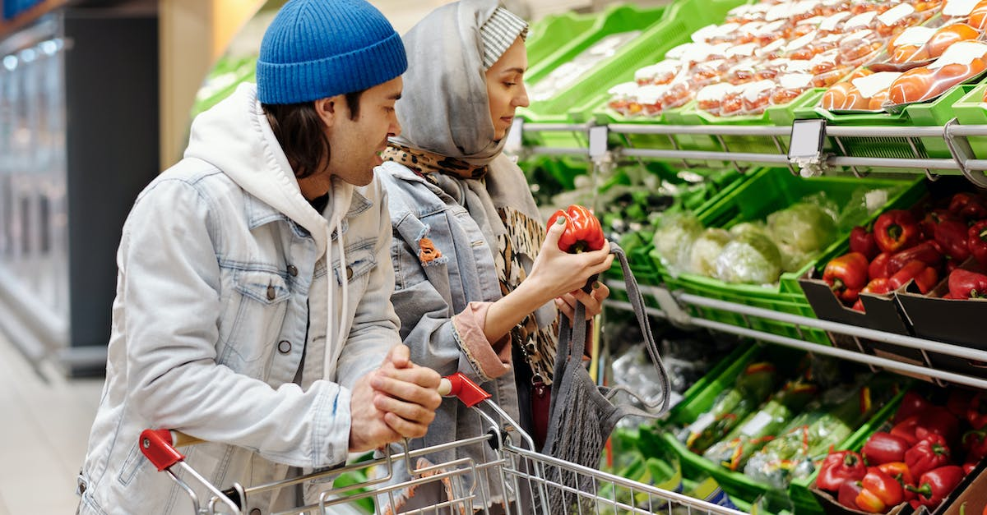
Supplemental Nutritional Assistance Program (SNAP)
Eligible individuals receive benefits to use towards nutrition
SSA is a SNAP authorized retailer
EBT is accepted as payment for Groceries to Go program
SSA supports clients in applying for SNAP and providing information about eligibility and application process
Partnership with ALIVE!

Slide 7

Friendly Visitor Program
Volunteers matched with socially isolated older adults for weekly visits

Slide 8

Friendly Caller Pilot Program
What Is Friendly Caller and Why We Need This Service
More than just volunteers making “check-in” or “welfare check” calls
It’s a friendly phone call from a “human being” to an older adult at risk of compromising their physical, mental, social and emotional well-being
CareRing no longer provides service
Social Isolation and Loneliness Epidemic
IT WORKS!

Slide 9
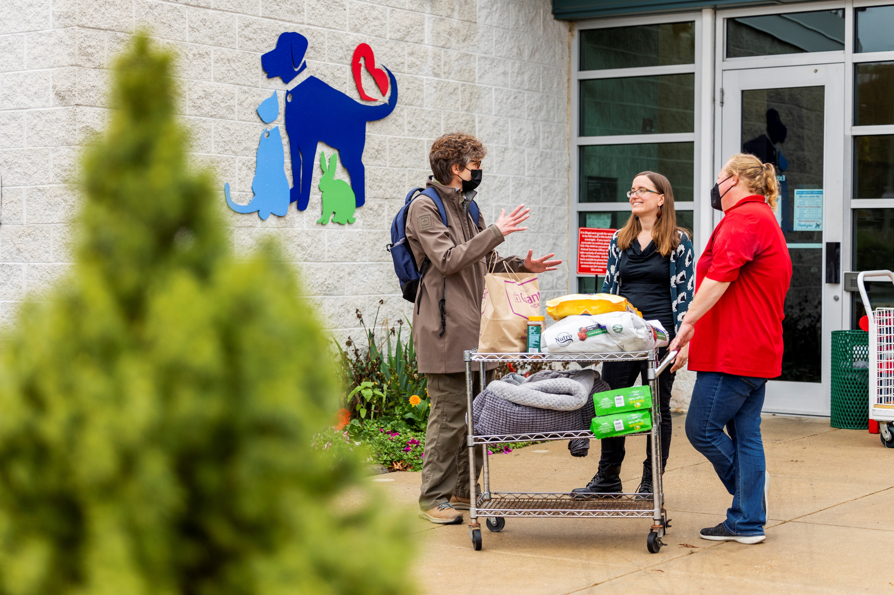
Animeals on Wheels
Delivery of pet food to pets of low-income
older adults.
Partnership with Animal Welfare League of Alexandria delivering pet food once a month

Slide 10
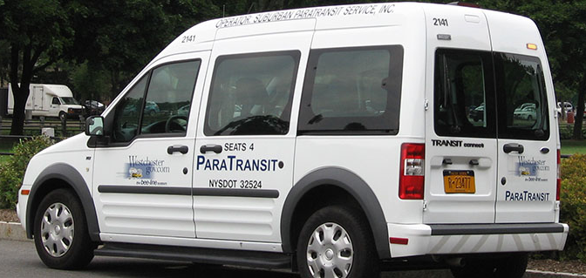
Transportation
DOT Paratransit
Provides transportation for persons who find it difficult to use public transportation. SSA manages the reservations for client

Slide 11
Education and Information
Senior Living in Alexandria Speaker Series
SSA partners with local experts, City agencies, and non-profits to provide up-to-date information. Events feature informational tables from partner organizations, covering topics like:
Senior Technology & Scams, Genealogy, Caregiver Support, Floral Arranging, Senior Academy, Health Fair, and
Senior Law Day – Co-presented with the Alexandria Bar Association, addressing legal issues for seniors.
Senior Ambassador Program A volunteer opportunity to advocate for seniors and share resources. Over 150 volunteers participate, including Spanish and Amharic Ambassadors.
Senior Information Corners are stocked by volunteers with current literature for seniors at 31 locations, including City libraries, the major recreation centers, continuing care facilities, and residential senior communities.

Slide 12
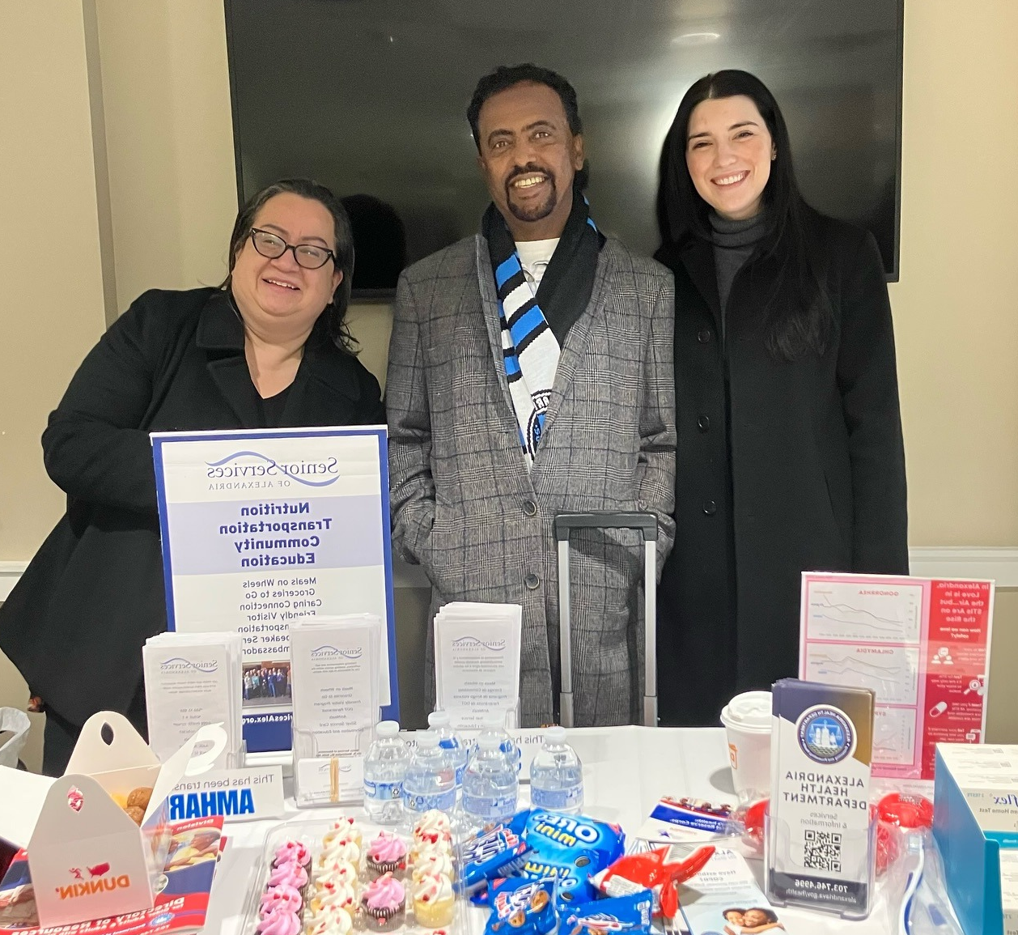
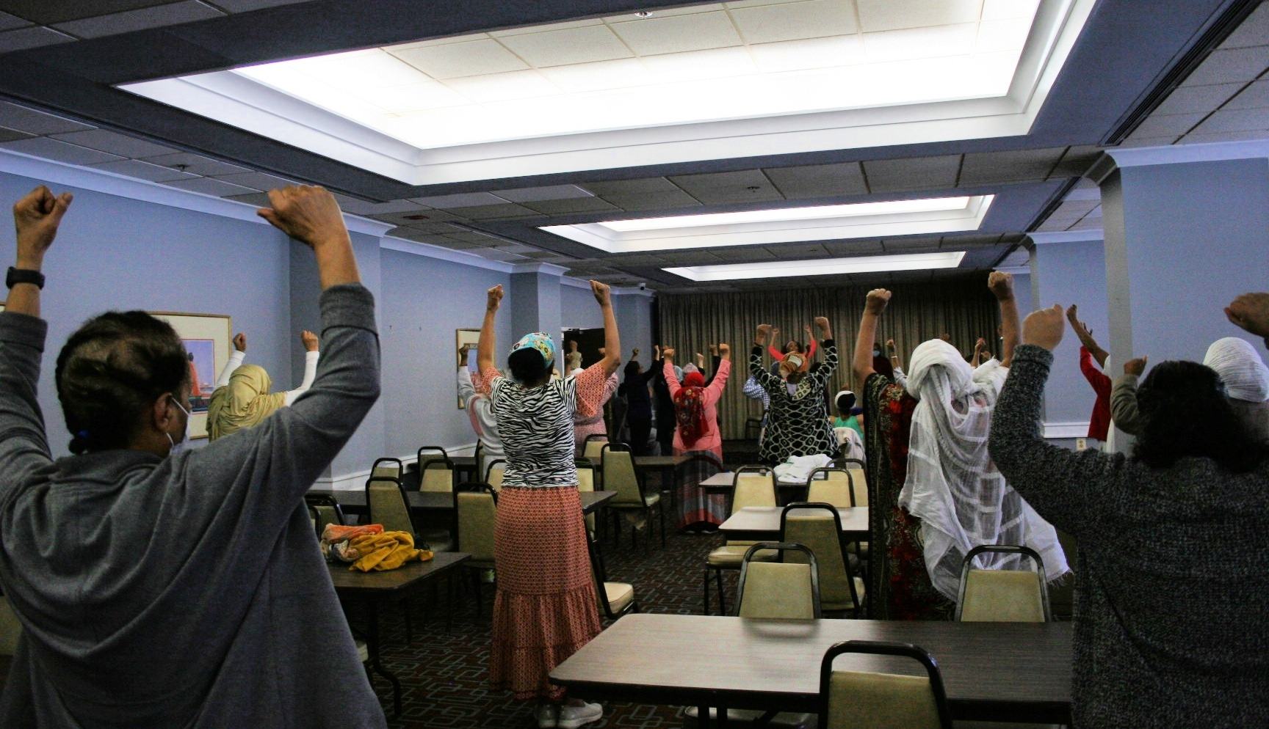
Community Outreach
SSA’s outreach team actively engages seniors through various programs and partnerships.
Impact:
Encourages active lifestyles
Builds social connections
Supports seniors with essential resources
Social Programs:
Weekly Bingocize at Casa Chirilagua for the Spanish speaking community
Weekly ALIVE! Food Pantry visits to spread vital information
Live Weekly Zoom Presentations for Senior Ambassadors
Wellness Programs:
Promoting physical health and wellness through regular exercise and nutrition classes at:
Claridge House for the Amharic-speaking community
Ladrey Highrise
In partnership with Goodwin Living, Virginia Cooperative Extension, and the City of Alexandria’s Recreation, Parks & Cultural Activities.

Slide 13

Silver Service Card
SSA and At Home in Alexandria co-sponsor a program to connect senior with local businesses
This card offers discounts to Alexandria seniors in participating locations
.
.

Slide 14
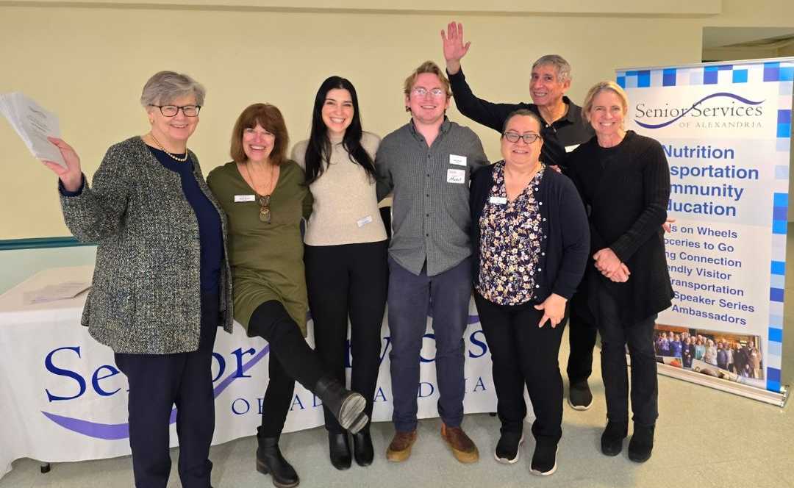
Contact SSA:
Website: www.seniorservicesalex.org
Telephone:
703-836-4414
Email: admin@seniorservicesalex.org
Facebook: https://www.facebook.com/SeniorServicesofAlexandria

