Slide 1
A Livable Community
Overarching goal: Enable older adults to remain in the community as long as possible
  Delay or avoid need for care facility
  Delay or avoid leaving Alexandria

Slide 2
Adult Day Services Center
5-day per week program, 7:30 a.m. – 5:30 p.m. for City residents age 55 and over
Therapeutic recreation
Nursing service, including medication monitoring and administration
Nutritious noon-time meal and snacks
Transportation using the DOT program
Supportive services for caregivers

Slide 3
Adult Protective Services
Investigates suspected abuse, neglect or financial exploitation
  Adults age 60 and over
  Adults with disabilities, age 18 and over
Public encouraged to report suspicion
  Identity of reporters remains confidential
  People can reject offer of help from APS

Slide 4
Adult Supportive Services
Care coordination for older adults and adults with disabilities
  Require on-going services
  Meet income guidelines – at or below 50% of the Virginia median income
Community Based Services – personal care services
Personal Emergency Response System
Options Counseling

Slide 5
Older Adult Mental Health
Assessments
Emergency intervention
Counseling and therapy
Make home visits with Adult Protective Services, as needed

Slide 6
Additional Services
Guardianship – Conservatorship Program
VICAP [Virginia Insurance Counseling and Assistance Program]
  Provides Counseling for Medicare Issues, Part D Enrollment
  Volunteer Opportunities; VICAP & Guardianship
Transportation to and from the Senior Centers plus some Grocery Shopping
Seniors Farmers Market (June 1-Sept 30)
Senior Cool Care(May-October)

Slide 7
Contracts
Legal Services of Northern Virginia
Northern Virginia Long-term Care Ombudsman
Liquid Nutritional Supplement
Birmingham Green Nursing Home & Assisted Living
Senior Centers @ Charles Houston and St. Martin de Porres
Meals on Wheels
Senior Taxi

Slide 8
For More Information about Services
Division of Aging and Adult Services
  4850 Mark Center Dr.
  9th Floor
  Alexandria, VA 22311
  703-746-5999
  DAAS@alexandriava.gov
Ashley Johnson
Ashley.johnson@alexandriava.gov

Slide 9

Helping Alexandria’s Older Adults Age with Dignity
October 16, 2024

Slide 10
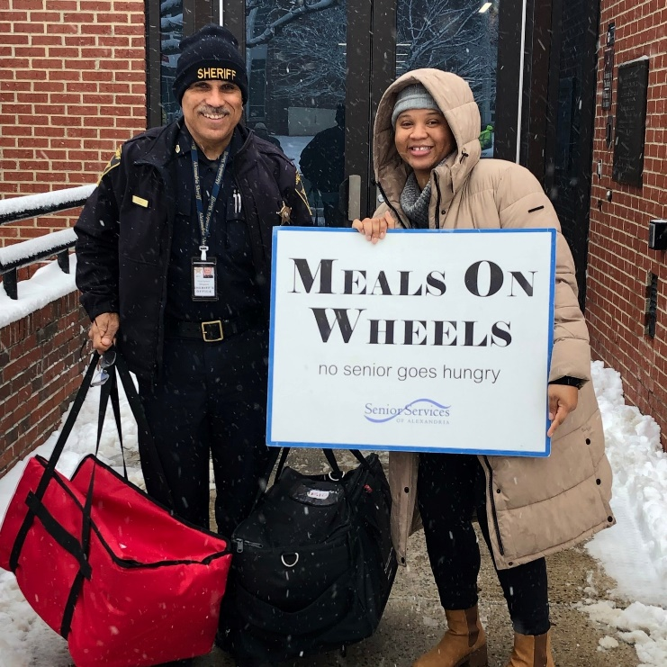
Meals on Wheels
Delivered 7 days a week to homebound seniors 60 and older
City Subsidized
Private Pay
Sponsorship Program

Slide 11
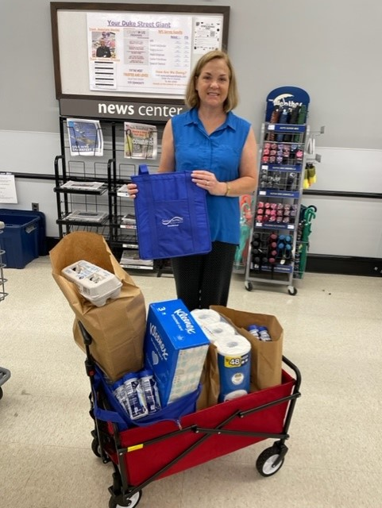
Groceries to Go
Volunteers deliver groceries ordered by phone or email to older adults who find shopping difficult.
Choice of Giant, Harris Teeter, Safeway
Volunteer Shops Every Two Weeks
No Delivery Fee, No Minimum Order

Slide 12
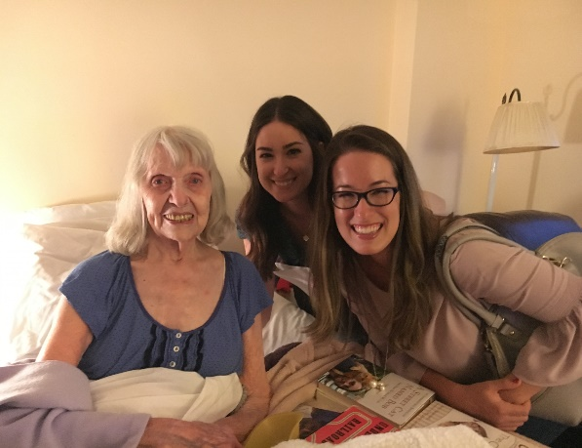
Companionship
Friendly Visitor Program
Volunteers matched with socially isolated older adults for weekly visits

Slide 13
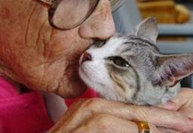
Animeals on Wheels
Delivery of pet food to pets of low-income
older adults.
Partnership with Animal Welfare League of Alexandria delivering pet food once a month

Slide 14
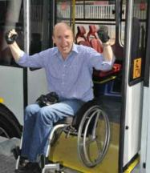
Transportation
DOT Paratransit
Provides transportation for persons who find it difficult to use public transportation. SSA manages the reservations for client
This Photo by Unknown Author is licensed under CC BY-NC

Slide 15
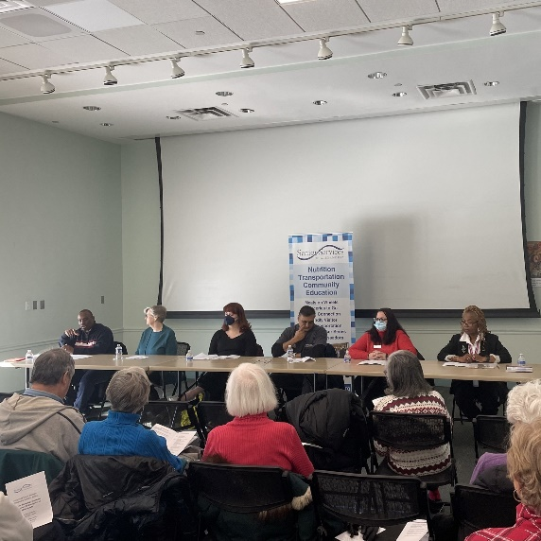

Education and Information
Senior Ambassadors – 140 volunteers
Spanish Ambassador program
“Senior Living in Alexandria” workshops - including Senior Technology and Scams, Genealogy, Caregiver Support, Floral Arranging, Senior Academy, Health Fair and Senior Law Day. Spanish programs include monthly Bingo!
Senior Information Corners – 27 around the city

Slide 16

Silver Service Card
SSA and At Home in Alexandria co-sponsor a program to connect senior with local businesses
This card offers discounts to Alexandra seniors in participating locations
.
.

Slide 17
Contact SSA: website – www.seniorservicesalex.org telephone – 703-836-4414 email – admin@seniorservicesalex.org
Facebook - https://www.facebook.com/SeniorServicesofAlexandria

