Slide 1

Affiliated with the GW
Center for Integrative Medicine

Slide 2

Four Directions Wellness
Connecting Body, Mind, Emotions, Spirit
Based in Del Ray, Virginia
Support the Medical Model
Complimentary Approaches
Thirty Plus Years in Healthcare

Slide 3
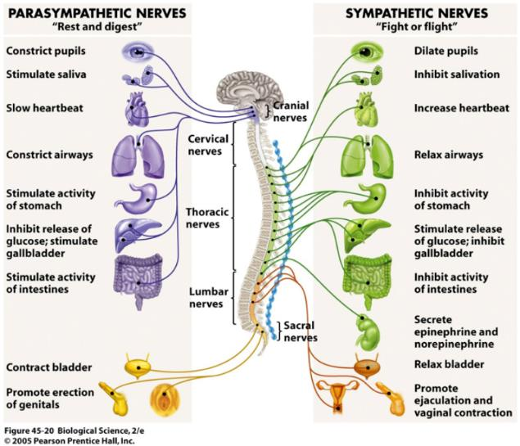
Autonomic Nervous System

Slide 4

Whole Person Care
Combining Eastern & Western Healing Techniques
Entirety of the Person is Evaluated
Assessments and Techniques used to support Whole Person – Nonpharmacological Approaches

Slide 5

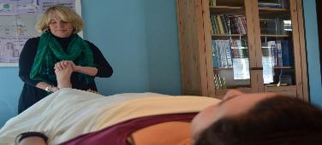
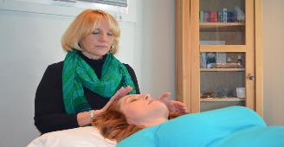
Eastern Approaches
Some examples include:
India: Yoga and Chakra System
China: Qigong, Tai Chi, Acupuncture, Meridians
Japan: Reiki
Native American: Shamanism
Greeks/Romans: Meditation

Slide 6

Types of Evaluations
Physical: Pains, Tensions
Mental: Limiting Beliefs
Emotions: Depression, Anxiety
Spirit: Passions
Environmental: Clean Water

Slide 7
Defining Principles
The patient and practitioner are partners in the healing process.
All factors that influence health, wellness and disease are taken into consideration, including body, mind, spirit and community.
Providers use all healing sciences to facilitate the body’s innate healing response.
Effective interventions that are natural and less invasive are used whenever possible.
Good medicine is based in good science. It is inquiry driven and open to new paradigms.
Alongside the concept of treatment, the broader concepts of health promotion and the prevention of illness are paramount.
The care is personalized to best address the individual’s unique conditions, needs and circumstances. Duke University Integrative Medicine

Slide 8
Types of
Integrative Therapies
Complimentary and Alternative Medicine (CAM)
Acupuncture/Chiropractic/Massage
Energy Healing Therapies/Reiki
Guided Imagery/Meditation
Nutrition/Natural Products
Qi Gong/Tai Chi/Yoga
Spiritual Care
Traditional Healers: Botanic, Shaman, etc.
    NIH-NCCAM Research
    2007 – Revised in 2012

Slide 9
Resources
GW Center for Integrative Medicine http://www.gwcim.com
National Institutes of Health http://www.nih.gov
Academy of Integrative and Holistic Medicine https://www.aihm.org
Samueli Institute https://www.samueliinstitute.org
Kaiser Permanente http://www.healthjourneys.com/Store?gclid=COXey7ma68sCFYJZhgodQhgAug

Slide 10
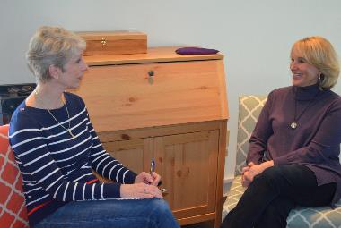

Four Directions Wellness
Services Include:
  - Individual Sessions
  - Classes (Silver Card)
  - Employer Wellness
  - Consulting Services
  Contact Information:
  Mara Benner
  703-776-0102
  mara@fourdirectionswellness.com
  www.fourdirectionswellness.com

